Slide 1
Astrology Basics

Slide 2
Jyotish
Jyotish is the correct word for this science not Astrology
Jyotish is the second name of lord “Sun” who is responsible for life on this planet.
Sun is the karaka for light
Jyotish means ‘A light recognizing the light”
We all are light since in our scriptures “The soul is define as a light”
So when one jyoti recognize and understand other jyoti is called “jyotish”

Slide 3
“Jyotishi”
Jyotishi is the actual word for an Astrologer.
In Sanskrit it is called “daivagna” (the one who knows the Divine is called daivagna)
So to hold such an important post you have to follow certain norms.
For better connection with the divine:
You need to do your sadhana
Chant the Gayatri Mantra
Take care of food habits
Maintain a sattvik nature

Slide 4
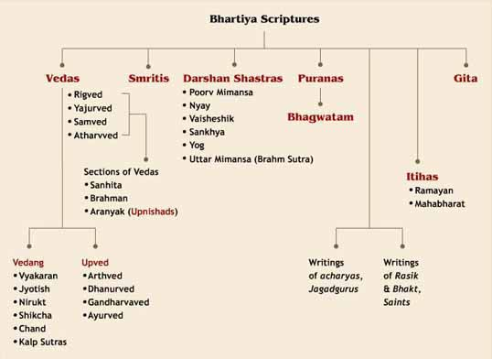
Classification of Bhartiya scriptures

Slide 5
The 4 Vedas:
The Rig Veda talks about all the principles that exist in the world. It has an Upaveda called the Sthapatya Veda.
The Yajur Veda talks about the application of principles. It’s Upaveda is called
Dhanurveda.
The Sama Veda talks about all the possible rhythms present in the universe. It has an Upaveda called the Gandharva Veda.
The Atharva Veda talks about how everything impacts everything else. It has an Upaveda called Ayurveda.

Slide 6
The 6 Vedangas are:
Shiksha - knowledge about all the phonetics is complied in this Vedanga. All the sounds that are present in the universe, heard and compiled by the Rishis form the first limb of Veda, called shiksha.
Nirukta – covers etymology, and is the study concerned with correct interpretation of Sanskrit words in the Vedas. Language aspect of Sanskrit word.
Vyakaran is grammar. Grammar is bringing all the words in a meaningful manner
Chhanda is the mastery of rhyme and meter..
Jyotish - Auspicious time for rituals, astrology and astronomy. This auxiliary Vedic discipline focused on time keeping. Jyotish never talks or encourages akarma (non- action).
Kalpa - means the context. So, even if we say everything in right intonations and right pronunciations and if the context is wrong, we may end up making a blunder. Kalpa deals with ritual instructions. This field is focused on standardizing procedures for Vedic rituals, rites of passage rituals associated with major life events such as birth, wedding and death in family, as well as discussing the personal conduct and proper duties of an individual in different stages of his life.

Slide 7
Classification of Karmas:
Sanchit karmas: accumulated karmas.
Prarabdha karmas: aayu,jaati,bhog
Kriyamana karmas: karmas, which we are doing now.
Agami karmas: anything that you plan to do in future

Slide 8
Branches of Jyotish:
Sidhanta - The study of movement of planets which helps with astronomical calculations.
Samhita - The macro consciousness on the earth gets affected by planetary
movements.
Jataka (Hora Shastra) - study of individual horoscopes
Jatakas further divided into any fields:
Phalit - Study of individual horoscope
Muhurutha - understanding timing
Upaya - Is the remedial par

Slide 9
How the sky is divided

Slide 10
Fixed division
We have sky around us, and the rishi’s has divided the sky into 12 equal parts.
The sky is 360 degree and rishi’s has divided this space into 12 equal parts.
These equal parts are called “Rashis” or “Signs”
The order starts from 1 and end at 12. they follow the same order always
The number 1 is Aries and so on.
This order is always fixed and follow the same pattern.
In these spaces there are some images also which is formed by various stars.

Slide 11
All these rashis are divided with the reference of Earth.
We know that all the planets revolve around Sun but for Rashis, Rishi’s divided the sky with reference of earth.
So if the sky is 360 degree each rashi is 30 degree
Further the sky is divided in 27 equal parts. These parts are also fixed and they are called “Nakshatra”
So if the sky is 360 degree, so if divide 360/27 i.e. 13.33 degree for each nakshtra.
That means each Rashi will have 2.25 nakshtra

Slide 12
Now each nakshatra is divided in 4 equal parts.
These equal parts are called “Charan” or “Padas”.
It is one step of moon while travelling. So moon travel 27x4 = 108 steps to cover all the sky.
That is the reason 108 number is so important in hindus.
We have 12 rashis and 9 planets that is also 108.

Slide 13
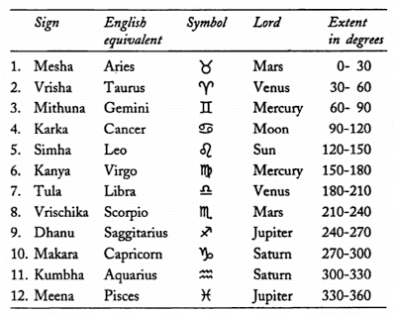

Slide 14
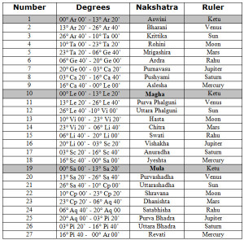
Nakshatra and their lords

Slide 15
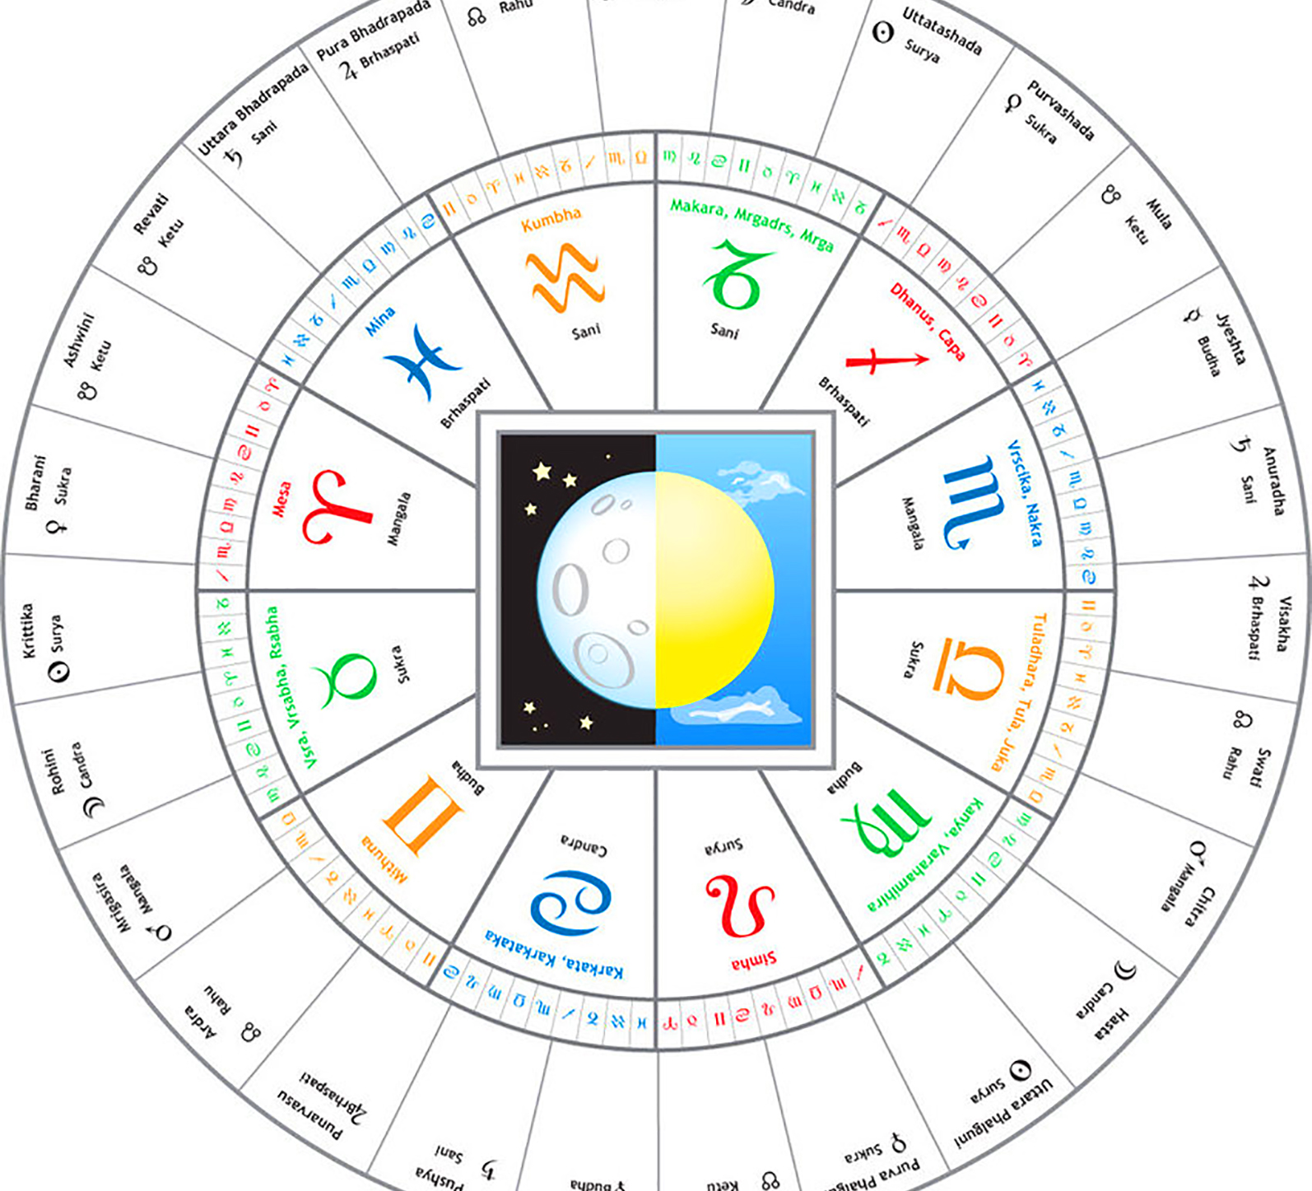
Sky divided in 108 parts

Slide 16
Dynamic division
In first division we have divided the entire sky into fixed spaces, we have divided them with reference of earth
But the Earth is moving. So if we look at one point for some hours, we see different parts of sky because the earth is moving.
So if we look at eastern horizon we will see different different rashi.
So we have divided the sky according to different direction. Please see the image

Slide 17
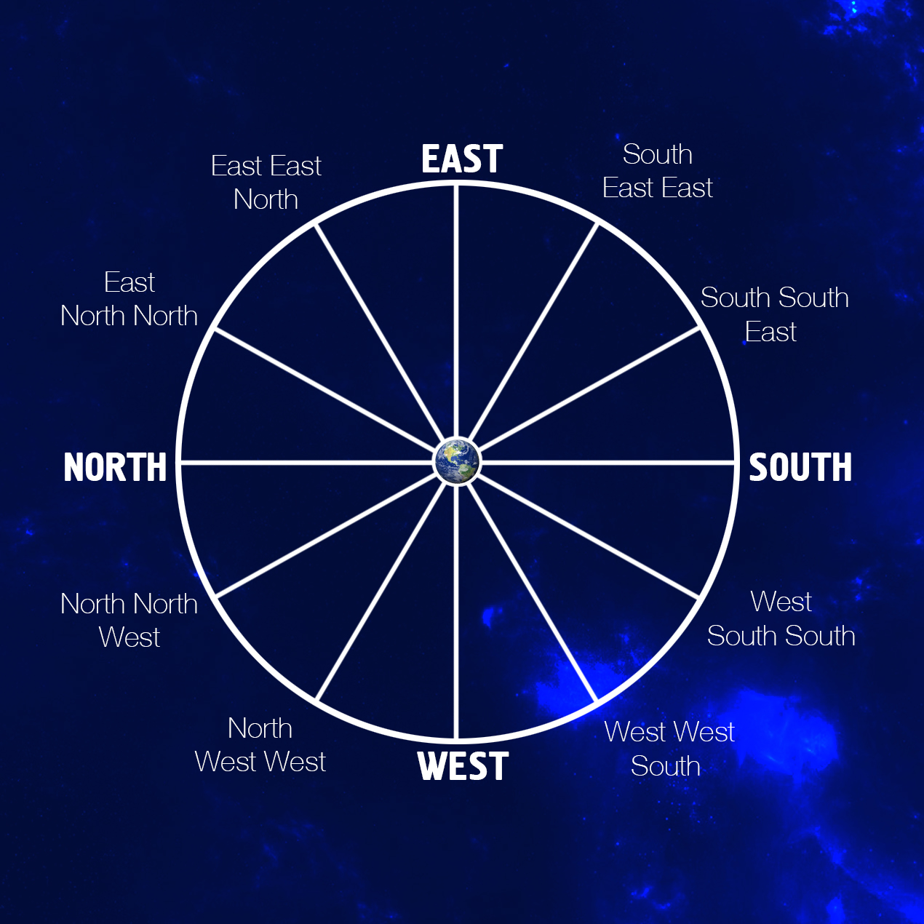
Zodiac divided as per directions

Slide 18
So when we divide this sky from our point, it’s a dynamic division
These divisions are called “Bhavas” or “Houses”
So If we are looking at Eastern direction, we can see Aries. And in 24 hours we will see the entire space of sky
That means we see all the rashis will come from our point of sight.
So if we divide this 24 hours with 12 rashis, 24/12=2 we will have new rashi after every 2hours in eastern direction.
We call this duration as Lagna or Ascendant. So after every two hours the lagna is changing i.e. we are seeing different rashi rising in the east.

Slide 19
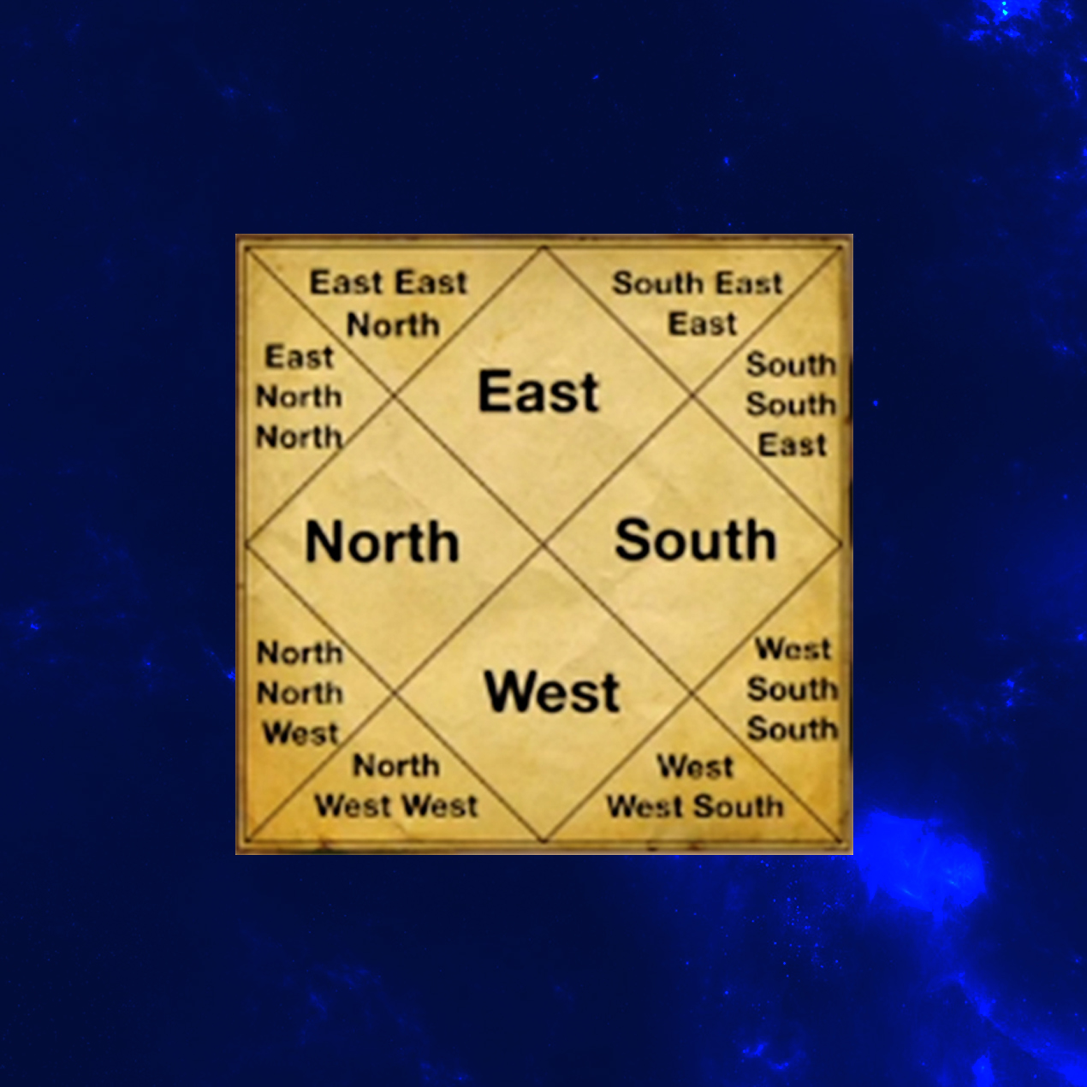
North Indian

Slide 20
Graha and Avatars of Vishnu
AVATAR | GRAHA
SUN | RAM
MOON | KRISHNA
JUPITER | VAMANA
MARS | NARSIMHA
MERCURY | BUDDHA
VENUS | PARASHURAMA
SATURN | KOORMA
RAHU | VARAHA
KETU | MATSYA
LAGNA | KALGI

Slide 21
The Panchmahabhutas
Element | Description | When stabilized
Bhoomi(Earth) | Body,sense of smell,excess lead to clinging on ideas and forms | Holding the posture stabilizes and relaxes the body
Aakash(Ether) | Pure consciousness,awareness,sense of sound,speech | Perception becomes clear and mind is in present momement and bliissfull
Vayu(Air) | Movement of all sort,sense of touch which activate the hand, feeling any thing comes from vayu. Too much air leads to ungrounded, aloof,dry or sterile | Struggling stops,perception clear
Agni(Fire) | Digestion of food and impressions,Ego, Control our sight.the ability to see, Desires | Stable emotions allow mental peace and remove desire and motivation increases
Neer(Water) | Sense of taste,emotions,memory and sensory impressions, excessive water can lead to emotional disbalance and dependence | A stable, relax mind stabilizes the emotions and senses

Slide 22
How meditation and Yoga helps
We connect to universe(Aakash) through the breath(vayu)
Deep breathing slows,deepens and stabilizes the mind’s desire and passion(fire)
With the passions controlled we can observe the senses and emotions(water), which become balanced
They the body becomes stable(bhoomi)

Slide 23
Three Gunas
Guna | Manifested though | Description
Tamas | Body/Form | Inertia, ignorance, attachment,
Rajas | Mind/Activity | Passion and desire
Sattwa | Spirit/harmony | Satta,chit, anand

Slide 24
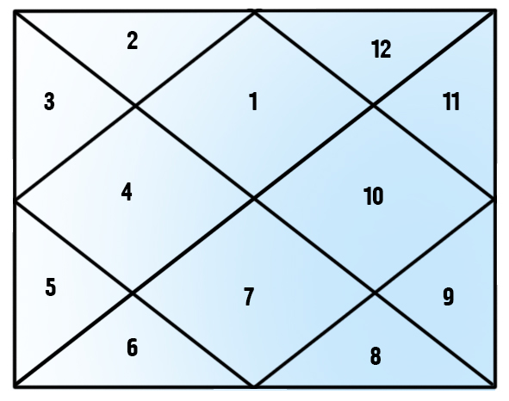
How to cast the horoscope
.

Slide 25
So we have different rashi’s rising in the east at different time.
After every two hours the rashi rising changes.
In North Indian chart the houses are fixed and Rashi’s are moving.
So suppose if at this time Leo is rising, we will place leo at the east in north Indian chart.
So the chart will look like this.

Slide 26
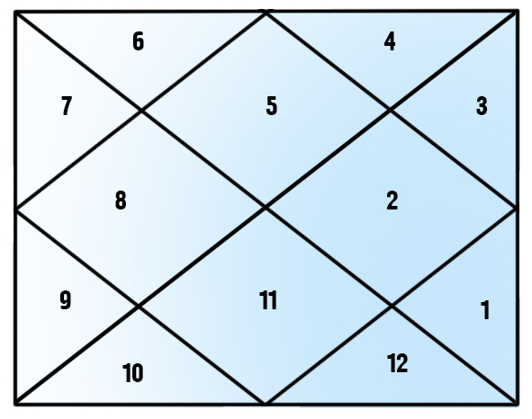
Position when Leo is rising in the east.

Slide 27
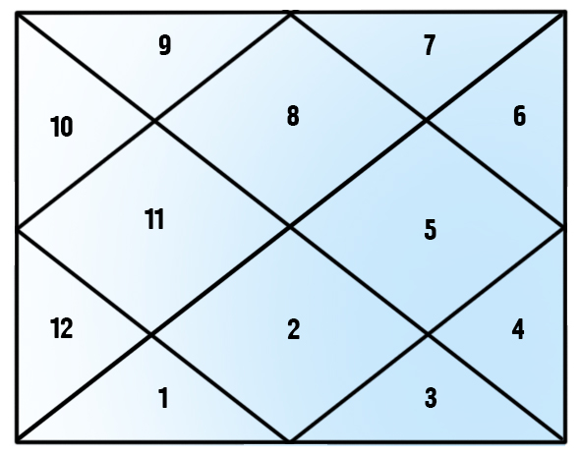
Position when Scorpio is rising in east
Suppose after 6 hours the Scorpio is rising, so the chart will look like this.

Slide 28
So we keep East in the first house of chart, so the sign ascend from here, that is called Ascendant, that is the reason the first house is called the ascendant or lagna
We can calculate the movement of sun also, if we put sun in the east.
In general principle since sun rises in the east, the rashi in which sun will be moving will be the first lagna of any day.
So we can see the movement of sun through chart also.

Slide 29
Movement of Sun
Sun starts in the first house
In afternoon moves to 10th house
Sunset comes in 7th house
Midnight at 4th house
That mean it travels each house in 2 hours and complete the day in 24 hours.

Slide 30
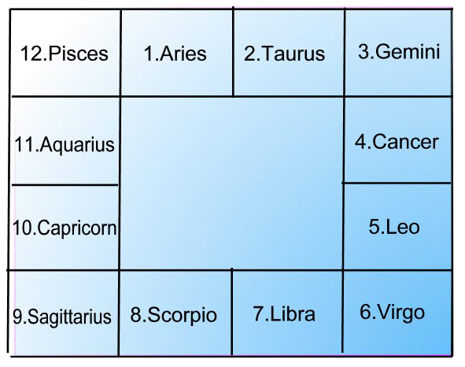
The South Indian chart

Slide 31
South Indian chart
In south Indian chart the bhavas are not fixed but the rashi is fixed.
These rashi follows the fixed order.
The lagna is moving in south Indian chart.
According to the lagna the houses also moves in south Indian chart.

Slide 32
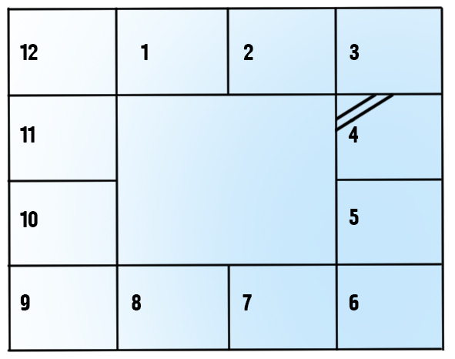
Lets replace the rashi’s name by numbers.
the lagna or ascendant is marked by two lines in south Indian chart.

Slide 33
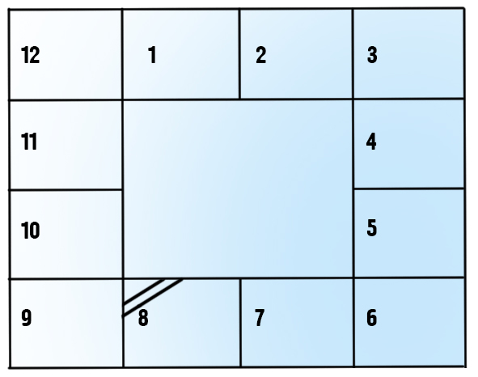
More example- Scorpion Ascendant

Slide 34
Sun- Astronomical facts
Sun, the largest body and a star at the center of our solar system it is made mostly of hydrogen and helium
has a diameter of about 1.4 million kilometers. It contains more than ninety-nine percent of total mass of our solar system. Its mean distance from the earth is about 149 million kilometer.
Its average geocentric motion per day is 00°59'08". The Sun never seems retrograde as it is stationary and located in center of solar system and all the planets revolve around it.

Slide 35
Sun- Mythological Story
The Sun God is the source of all life and energy that exist in the universe. In hindu mythological, the abode of Sun god is known as Suryaloka, and this sphere is next to the physical world or bhu-mandala
. Sage Kashyap and his wife Aditi gave birth to Indra, Visnu, Vivasvan, Miter, Amsuman, Dhata Tvasta, Pusa, Varuna, Aryama, Bhaga and Savita. These twelve sons of Aditi become know as twelve Adityas. Lord Bramha selected Savita from theses twelve Adityas and blessed him by saying only he will be worshiped and all other Adityas will be merged in him.
But these twelve Aditayas exerts their force separately which gave rise to twelve months and each of them are said to rule over the each of the twelve months. As a result of this, we have different seasons and climatic changes.

Slide 36
The Sun god's wife Sanjana was the daughter of Vishvakarma, the celestial architect.
They had three children Vaivasvata, Yama (the god of death) and Yami. Sanjana was having tough time with Sun, not because of any discord between them but as Sun's light was too strong for her.
One day Sanjana decided to go away from home, leaving in her place her body double, Chaaya (shadow). For some time, Sandhya lived with her father and then left it too, she took the form of a mare and went to the mountains to pray.
Meanwhile, the Sun being unknown of this fact, continued to live with Chaaya and she gave birth to three more children, Savarni, Shani (later became the planet Saturn) and Taapti (later became a river). After passage of some more time Sun realized that Chaaya was not his wife and he went to look for her.
He saw his wife praying in the form of a mare and he turned himself into a horse and approached her amorously. This led to the birth of horse headed twins, Ashwini Kumara, the celestial physicians.

Slide 37
Sanjana told her husband that his light was too strong for her. Sun then decided to divide his light in to sixteen parts, each of which created different planets including Earth, while the Sun was left with one-sixteenth part of his original light and Sanjana came back to live with Sun.
The Sun's chariot is driven by Arun and have seven horses pulling the chariot, known as Gayatri, Brhati, Usnik, Jagati, Tristup, Anustup and Pankti.
These seven horses are metaphorically speaking are the seven colors which the Sunlight consists of and know as 'VIBGYOR’.

Slide 38
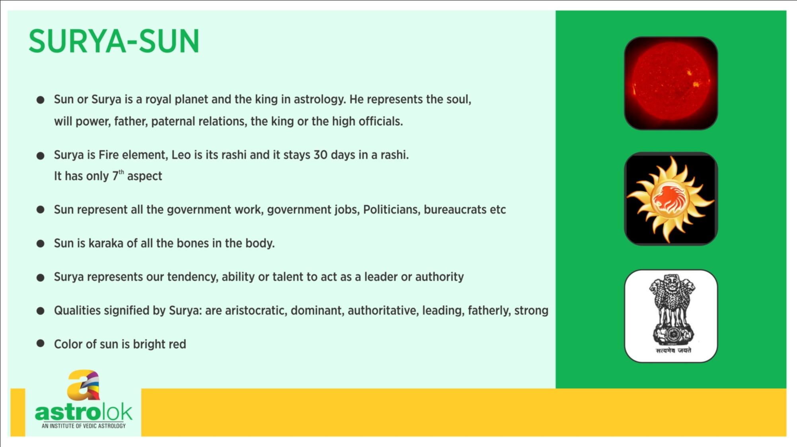

Slide 39
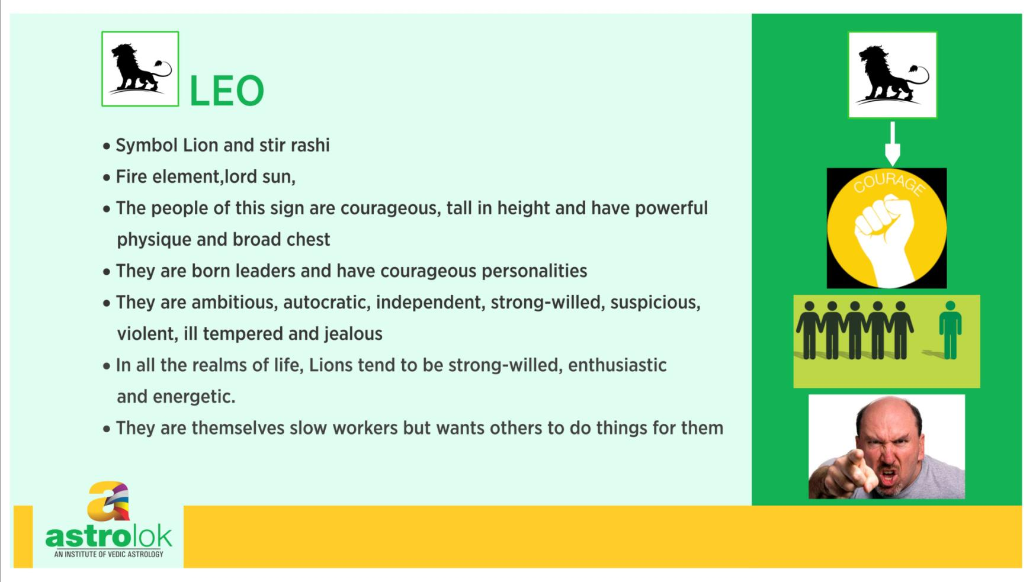

Slide 40
Moon- Astronomical facts
It is the only natural satellite of earth and only object in space visited by humans. It has a diameter of about 3,475 kilometers.
Its mean distance from the earth is about 3,84,403 kilometer. Moon takes 27.3 days to make one orbit around the Earth and it also takes exactly same duration, which is 27.3 days to complete one rotation on its axis. That's why we always see the same face of the Moon.
The Moon's gravity is about one-sixth than that of the Earth's. The surface of the Moon has many craters formed by meteor crashes. Moon is the causes tides in the Earth's large water bodies, because of the gravity force Its average geocentric motion per day is 13°10'35".
The Moon never seems retrograde as it rotates round the Sun along with Earth.

Slide 41
Story
Three supreme gods Brahma, Vishnu and Shiva disguised as monks, came to test Anasuya, the wife of Atri Rishi and demanded that she feed them milk from her breasts.
The great Anasuya with her spirutal powers got to know the truth and and turned these three gods into babies and feed them as they desired. Immensely pleased and impressed with Anasuya, lords of the universe blessed her to have great children.
Shiva's blessing caused the birth of Durvasas rishi, Vishnu's blessing resulted in the birth of Dattatreya, and Brahma's boon caused the Moon's birth.

Slide 42
The Moon was then worshipped by all the celestials. He later married all the twenty seven daughters of Daksha and they were non other than twenty seven constellations or nakshatras.
Out of his twenty seven wives Moon preferred only Rohini, and always remained with her. Other twenty-six sisters pleaded Moon to spend equal time with all of them.
But Moon ignored them and with no option left these twenty-six sisters complained to their father, Daksha, who tried twice to reason with Moon, his son in law, but Moon ignored it as well. Daksha then lost his temper and cursed the Moon to suffer with consumption.

Slide 43
Every day the Moon started to wane, losing his glow and no remedy could cure him. The gods also got alarmed at the possibility life on Earth will be affected without Moon, approached Daksha and asked him to modify his curse so that life continues on Earth.
Daksha then modified his curse on condition that Moon has to spend one day with each of his wives and the consumption will effect him for fourteen days and in next fourteen days he will gain back his form.
Thus, the Moon now waxes and wanes in cycle of twenty seven days and he visits each of his wife once a month, for one day. Moon had no children by his twenty-seven wives, but he have four sons by another wife, named Manohara. But most famous son of the Moon is the planet Mercury

Slide 44
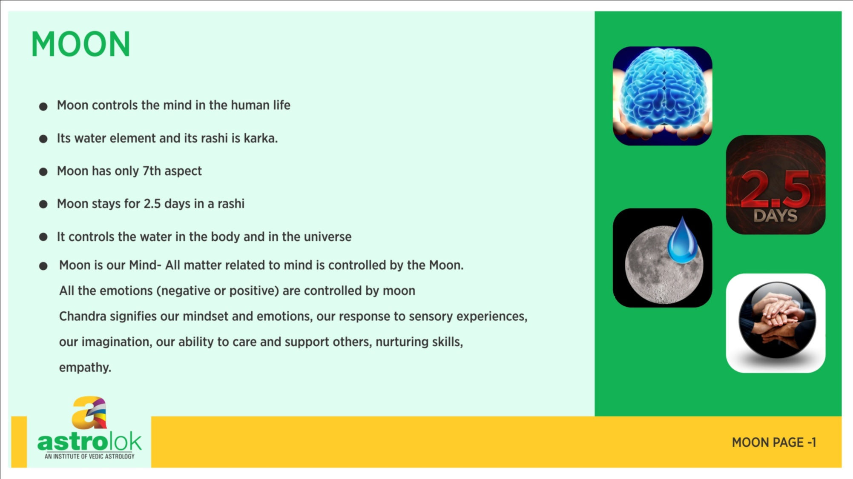

Slide 45
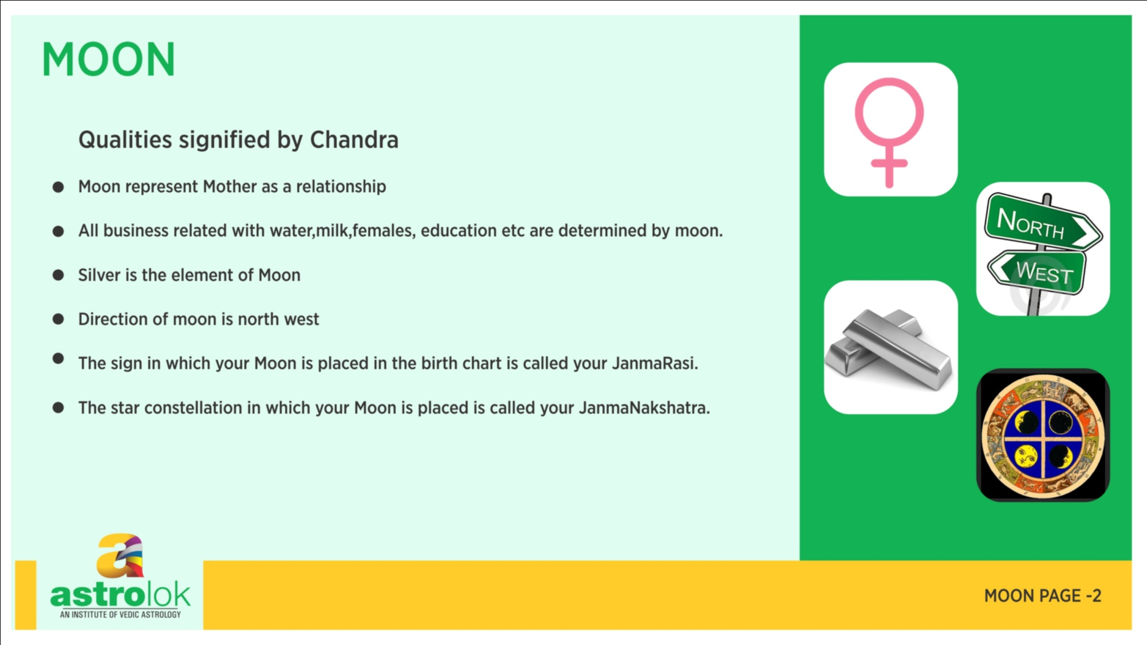

Slide 46
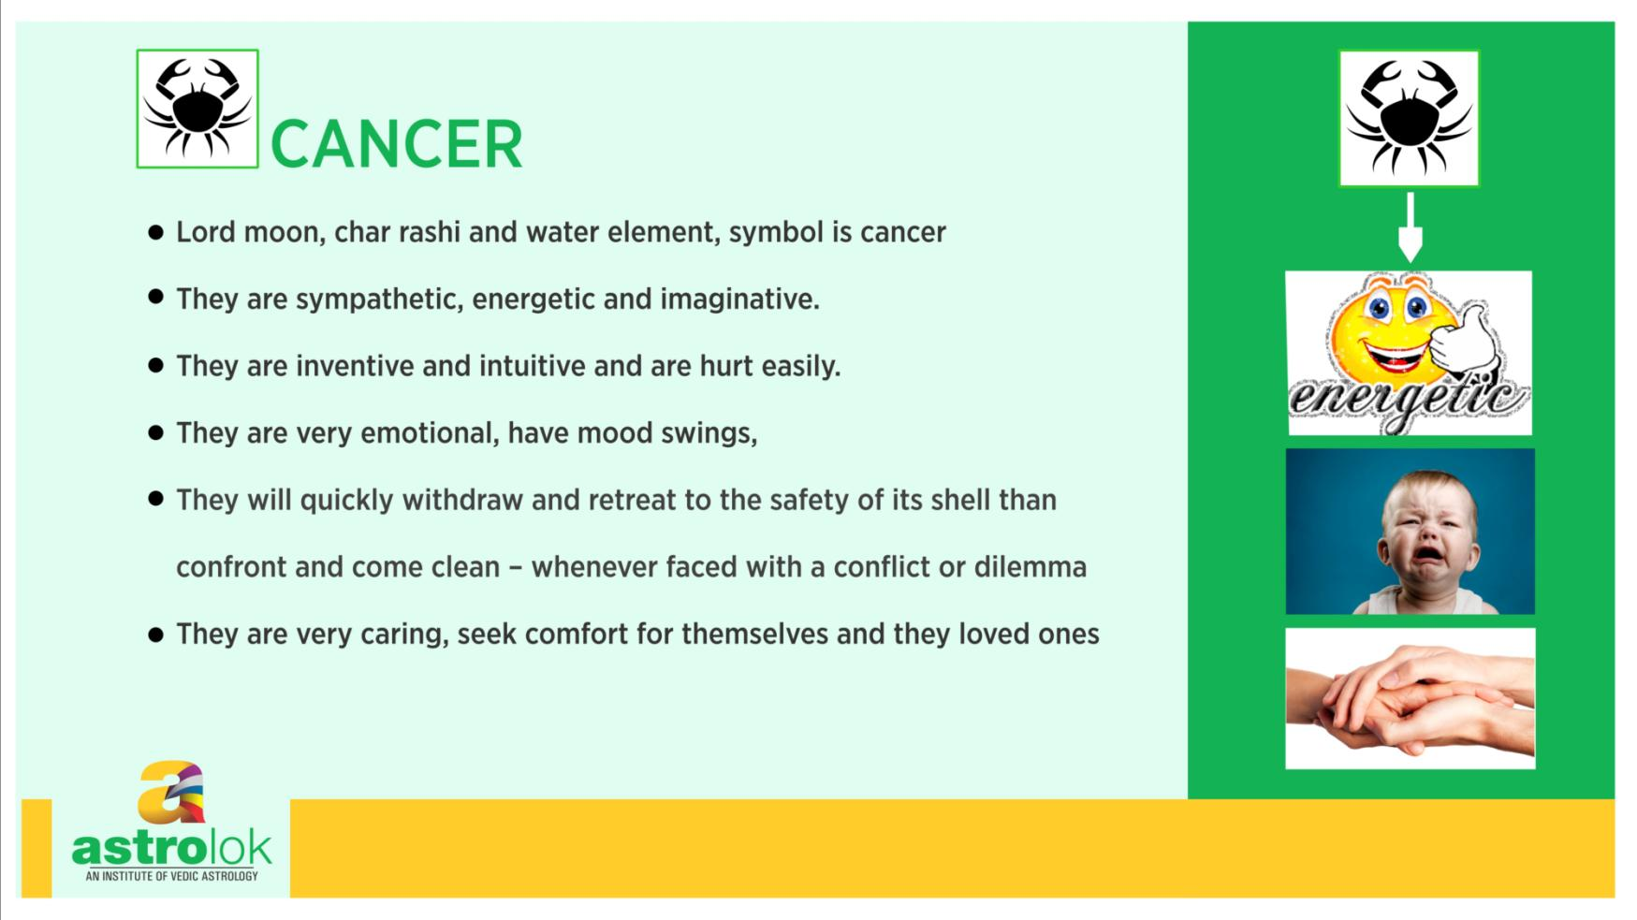

Slide 47
Mars- Astronomy
Mars is the fourth planet from the Sun and it is the first planet outside Earth's boundary. It appears to be of reddish color as seen from Earth.
It has a diameter of about 6,794 kilometers. Its closest distance from the Earth is about 56 million kilometers. From Sun its distance varies from 205 million kilometers to 249 million kilometers.
Mars takes 687 days to make one orbit around the Sun and it takes 24 hours and 37 minutes to complete one rotation on its axis.
Its surface temperature varies from 10°C to -120° C. Its average geocentric motion per day is 00°31'27". Mars have two natural satellite of its own, named Phobos and Deimos.
Mars retrograde period is about 60 to 80 days and it gets retrograde approximately every twenty six months.

Slide 48
Mythology
Daksha, the king of entire earth once organized the greatest yagna and invited all gods, demigods, sages, and other famous personalities. He however did not invite Lord Shiva, his own son-in-law.
When Sati, Lord Shiva's wife heard about this yagna she left to attend it inspite her husband's objections, but when she arrived there her father Daksha insulted Shiva. This was unbearable for Sati and she gave up her life. . .

Slide 49
On hearing the events that had taken place at Daksha's yagna, Lord Shiva's wrath reached its boiling point and in rage he pulled a hair from his matted locks and threw it on the ground and it became a fiery being of unequal strength with many heads and eyes, and thousands arms and legs.
His mare sight was enough to strike unparallel fear in strongest of hearts. Lord Shiva named him Virabhadra and commanded him to destroy Daksha and his yagna and anyone who tries to stop him

Slide 50
Virabhadra with Shiva's army of spirits and goblins reached the venue of the yagna and seeing him and his army all started to run in different directions to save themselves. Virabhadra destroyed Daksha's sacrifice, and then killed Daksha.
Virabhadra returned to Shiva who was extremely pleased with him, and granted him a permanent place in the heavens as a planet and named him Angaraka (Mars), the fiercest of planets.
As Lord Shiva directly produced Mars or Angaraka's, he is naturally referred as son of Lord Shiva just like his other son Karttikeya and it is said that those afflicted by Mars should worship Karttikeya

Slide 51
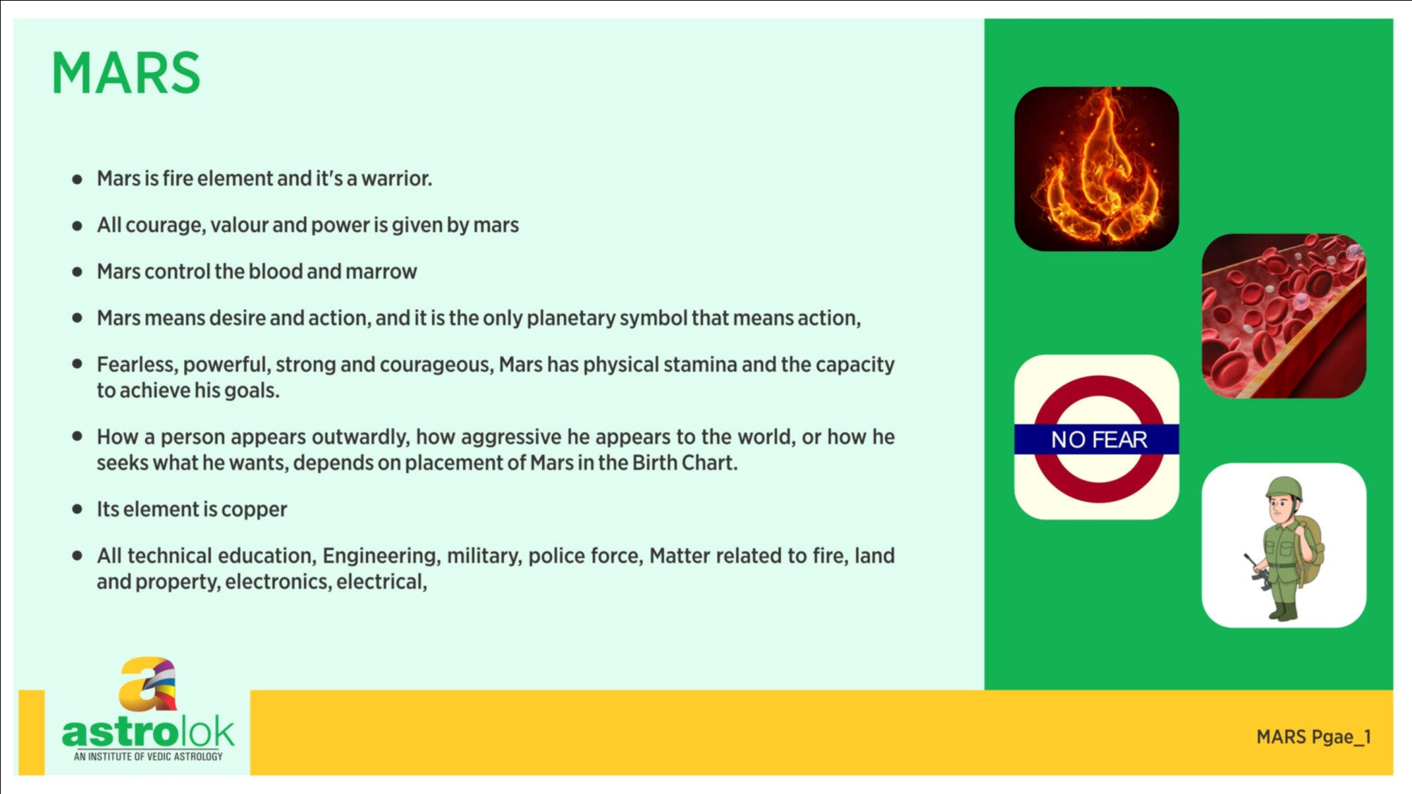

Slide 52
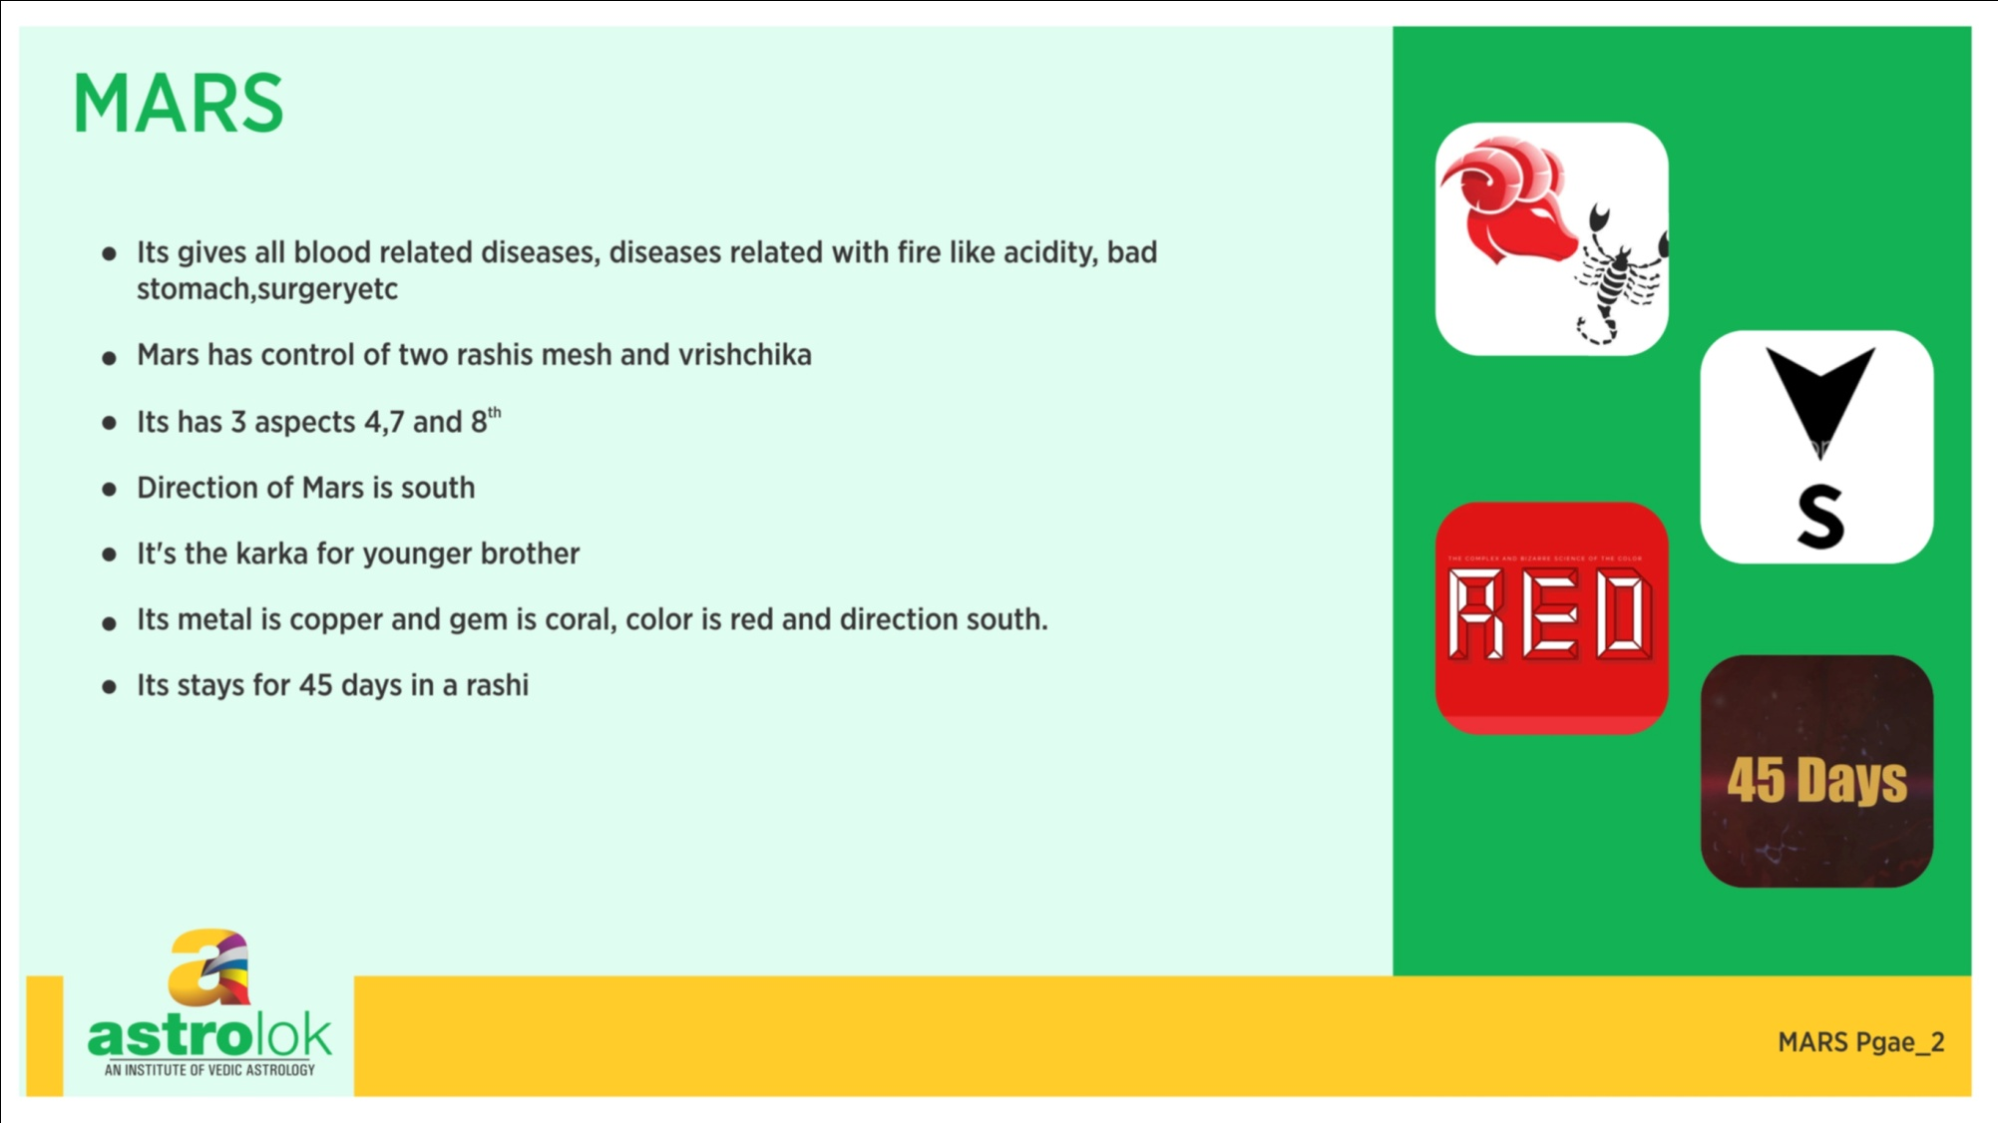

Slide 53
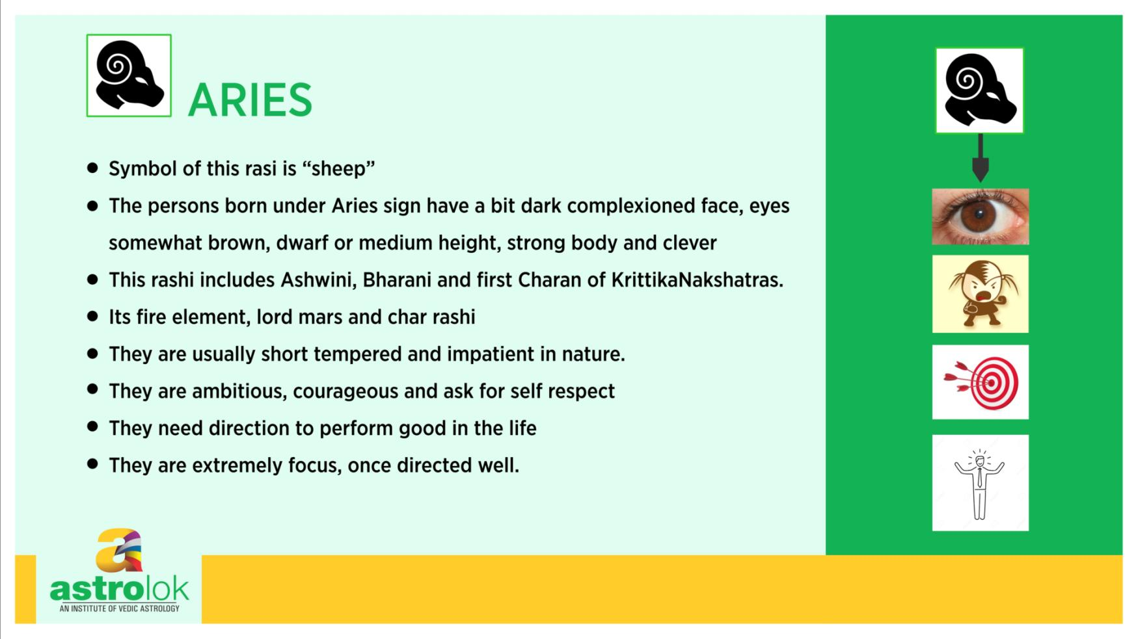

Slide 54
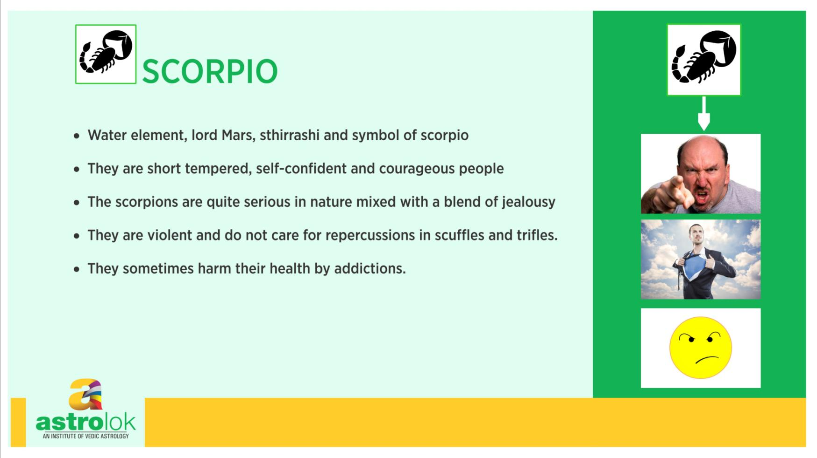

Slide 55
Mercury- Astronomy
Mercury is the planet closest to the Sun in our Solar System. Its orbit is one of the most eccentric among the planets. As seen from the Earth, Mercury never gets more than 27 degrees away from the Sun.
It has a diameter of about 4,879 kilometers. Its distance from the Earth varies from about 77 million to about 222 million kilometers. From Sun its distance varies from 47 million 70 million kilometers.
Mercury takes 88 days to make one orbit around the Sun and it takes 58.65 days to complete one rotation on its axis.
Its surface temperature ranges widely between -168°C to 427°C. Its average geocentric motion per day is 01°23'. Mercury has no natural satellite of its own.
Mercury retrograde period is about 20 to 24 days and it gets retrograde approximately every four months.

Slide 56
Story
Mercury is the son of the Moon. Moon conquered the three worlds and performed the Rajsu yagna, the sacrifice which gives lordship. Many gods and goddesses served him; having achieved this glory he became arrogant.
The Moon was the chief disciple of Jupiter, the guru of the celestials, and was also the favorite of Tara, Jupiter's wife, who was attracted to him by his character and beauty.

Slide 57
Once when Jupiter was away Tara and Moon eloped. Jupiter returned home, found his wife gone, soon discovered her whereabouts, and several times sent messages to the Moon requesting his wife's return.
The Moon, however, repeatedly refused to comply with these requests, maintaining that Tara had accompanied him of her own accord and would leave only when she was satiated with him.
These replies so infuriated Jupiter that he communicated them to his disciple Indra, the chief of gods who sent an ultimatum to the Moon.

Slide 58
When Moon refused to yield again, Indra began a war. Venus and the asuras (demonic celestials) took the side of Moon in this war, because of the ongoing enmity between Jupiter and Venus, while Lord Shiva, took the side of the devas.
The war dragged on so long that the Great Rishis began to fear that the end of the world was near. Brahma asked Moon to return Tara.
This the Moon did, but he returned her pregnant.

Slide 59
When Jupiter learned of this he was furious, and asked her for abortion.
Tara had to did that but the baby which was a boy survived and he was radiant like gold.
Seeing the child's splendor both Jupiter and Moon hankered after him, and both claimed paternity, demanding that Tara declare the true father's name. Tara was too embarrassed to speak.
Finally, when Brahma questioned her in private she admitted that the Moon was the father of that wonderful child, who was the planet Mercury.

Slide 60
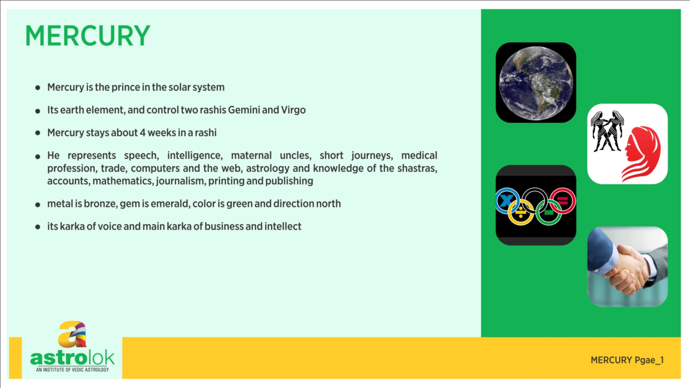

Slide 61
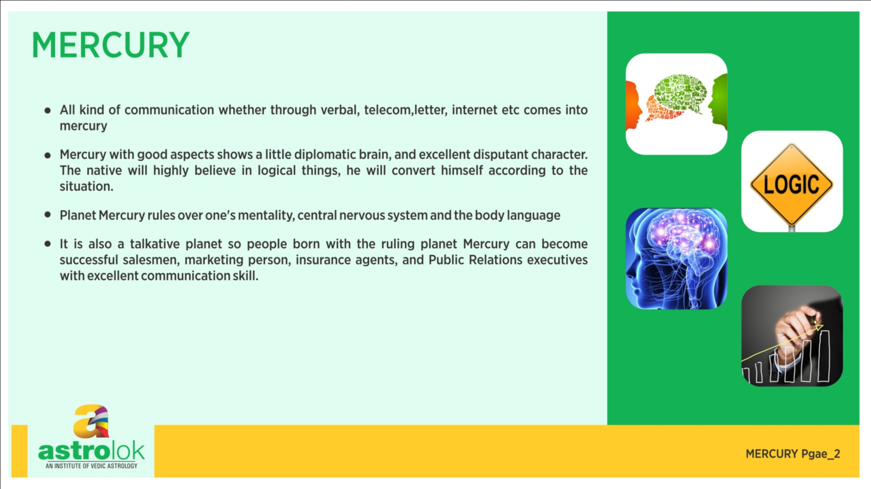

Slide 62
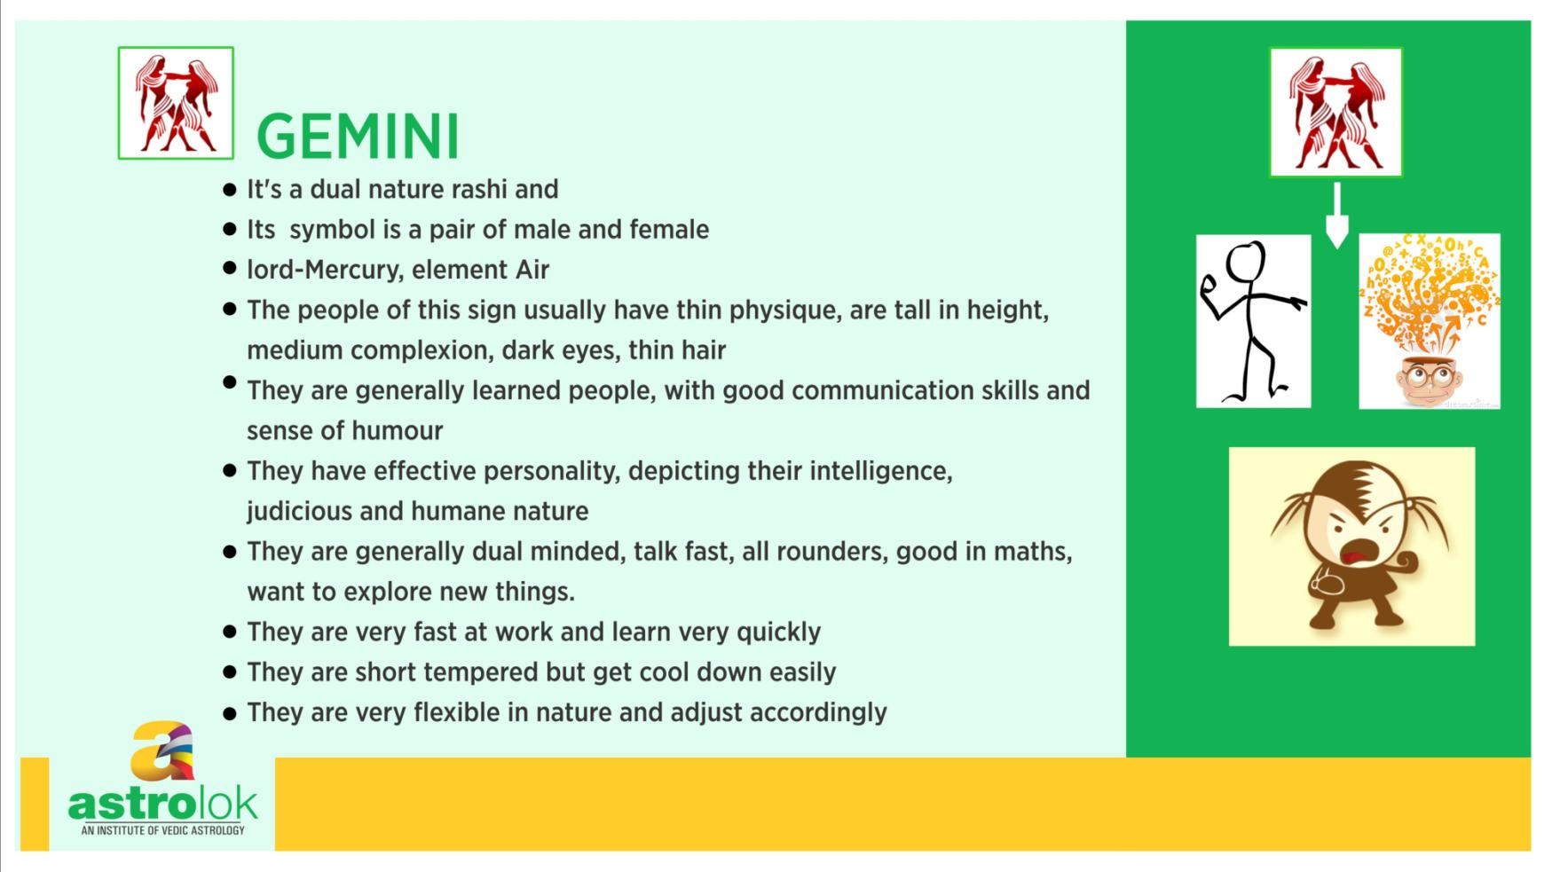

Slide 63
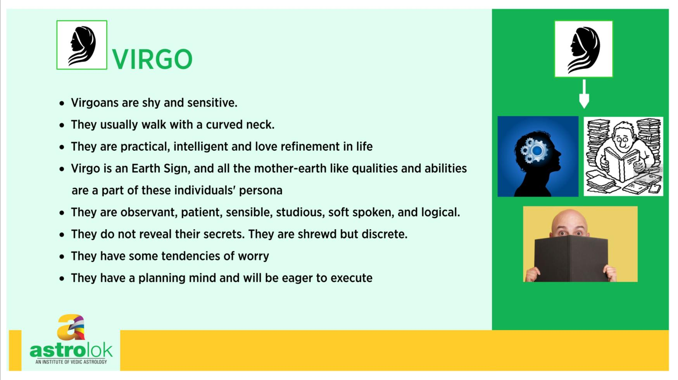

Slide 64
Venus- Astronomy
Venus is the second farthest planet from the Sun. It is the brightest thing in the sky besides the Sun and Moon. As seen from the Earth, Venus never gets more than 48 degrees away from the Sun.
It has a diameter of about 12,100 kilometers. It is closest planet to Earth and its minimum distance from the Earth is from about 40 million kilometers. From Sun its distance is 108 million kilometers.
Venus takes 225 days to make one orbit around the Sun and it takes 243 days to complete one rotation on its axis. Its average surface temperature is 452 °C and that makes it the hottest planet. Its average geocentric motion per day is 01°12’.
Venus has no natural satellite of its own. Venus retrograde period is about 40 to 43 days and it gets and it retrograde approximately every nineteen months.

Slide 65
Story
Venus is the guru of the demons, he can raise the dead, with the help of the Sanjivini Vidya, who fall in battles with the gods. He is immensely astute, and, a true Brahmana, he is an expert in every form of learning.
Venus has a medium-sized well-nourished body, long hands, prominent shoulders, a broad chest, and dark, short, curly hair. Overflowing with virility, he is intelligent, handsome, and sensuous.
Venus is the son of the Rishi Bhrigu and his wife Puloma.
Bhrigu Rishi was, like Angiras Rishi, (father of Jupiter) born directly from Brahma's semen, which means that Venus and Jupiter, two implacable adversaries, are first cousins. .

Slide 66
One day, when Bhrigu was absorbed in deep meditation, Venus was near him and was appreciating the beauty of the nature, at that time the beautiful Apsaras Vishvachi was passing by, seeing her boy's heart with delight and he followed her to heaven.
They fell in love at first sight of each other, and to fulfill his desire Venus created a hut in a small corner of heaven. Then they indulged in lovemaking of the many ages.
When Venus's good karmas had finally been used up, he fell from heaven down to the Moon, where his soul reached the Earth through rain that fell on a rice paddy.
Entering the semen of a Brahmana who ate that rice, and then entering the womb of that Brahmana's wife via his semen, Venus was reborn in that Brahmana family.

Slide 67
The Brahmana who had been Venus died of snake bite not long after, and then, reborn as prince of Madra, ruled that country for many years. Afterwards he took many other births, including one as a bamboo forest and another as a python, until at last he was born as the son of a Seer living on the banks of the river. His original body, meanwhile, had long ago dropped to the earth.
After many thousand years, Bhrigu opened his eyes to find not his living son but a worn-out body lying nearby.
He then led an austere life on Mount Meru for long, until his path again crossed that of Vishvachi, who had been cursed to live as a female deer. He fell in love with the deer and mated with her; the result was a human child
In his fury over his son's death, he was about to curse Yama, the god of death, when Yama appeared before him and asked him not to curse him, because his son fell into this state because of his own actions and he is now performing penance on the banks of the river Ganga

Slide 68
. Yama then revived the body of Venus; Bhrigu thereupon told the boy his past lives and showed him the road to spiritual success.
Venus set out to gain the favor of Lord Shiva and after worshipping him for five thousand years Lord Shiva appeared and blessed Venus and taught him the Sanjivini Vidya.
In addition, Shiva named Venus the best of the planets and told him that his rise in the sky would inaugurate the performance of all auspicious rituals. It is for this reason that marriages are performed only when Venus is rising in the sky. Venus himself has enjoyed several wives and has been blessed with daughters and sons.

Slide 69
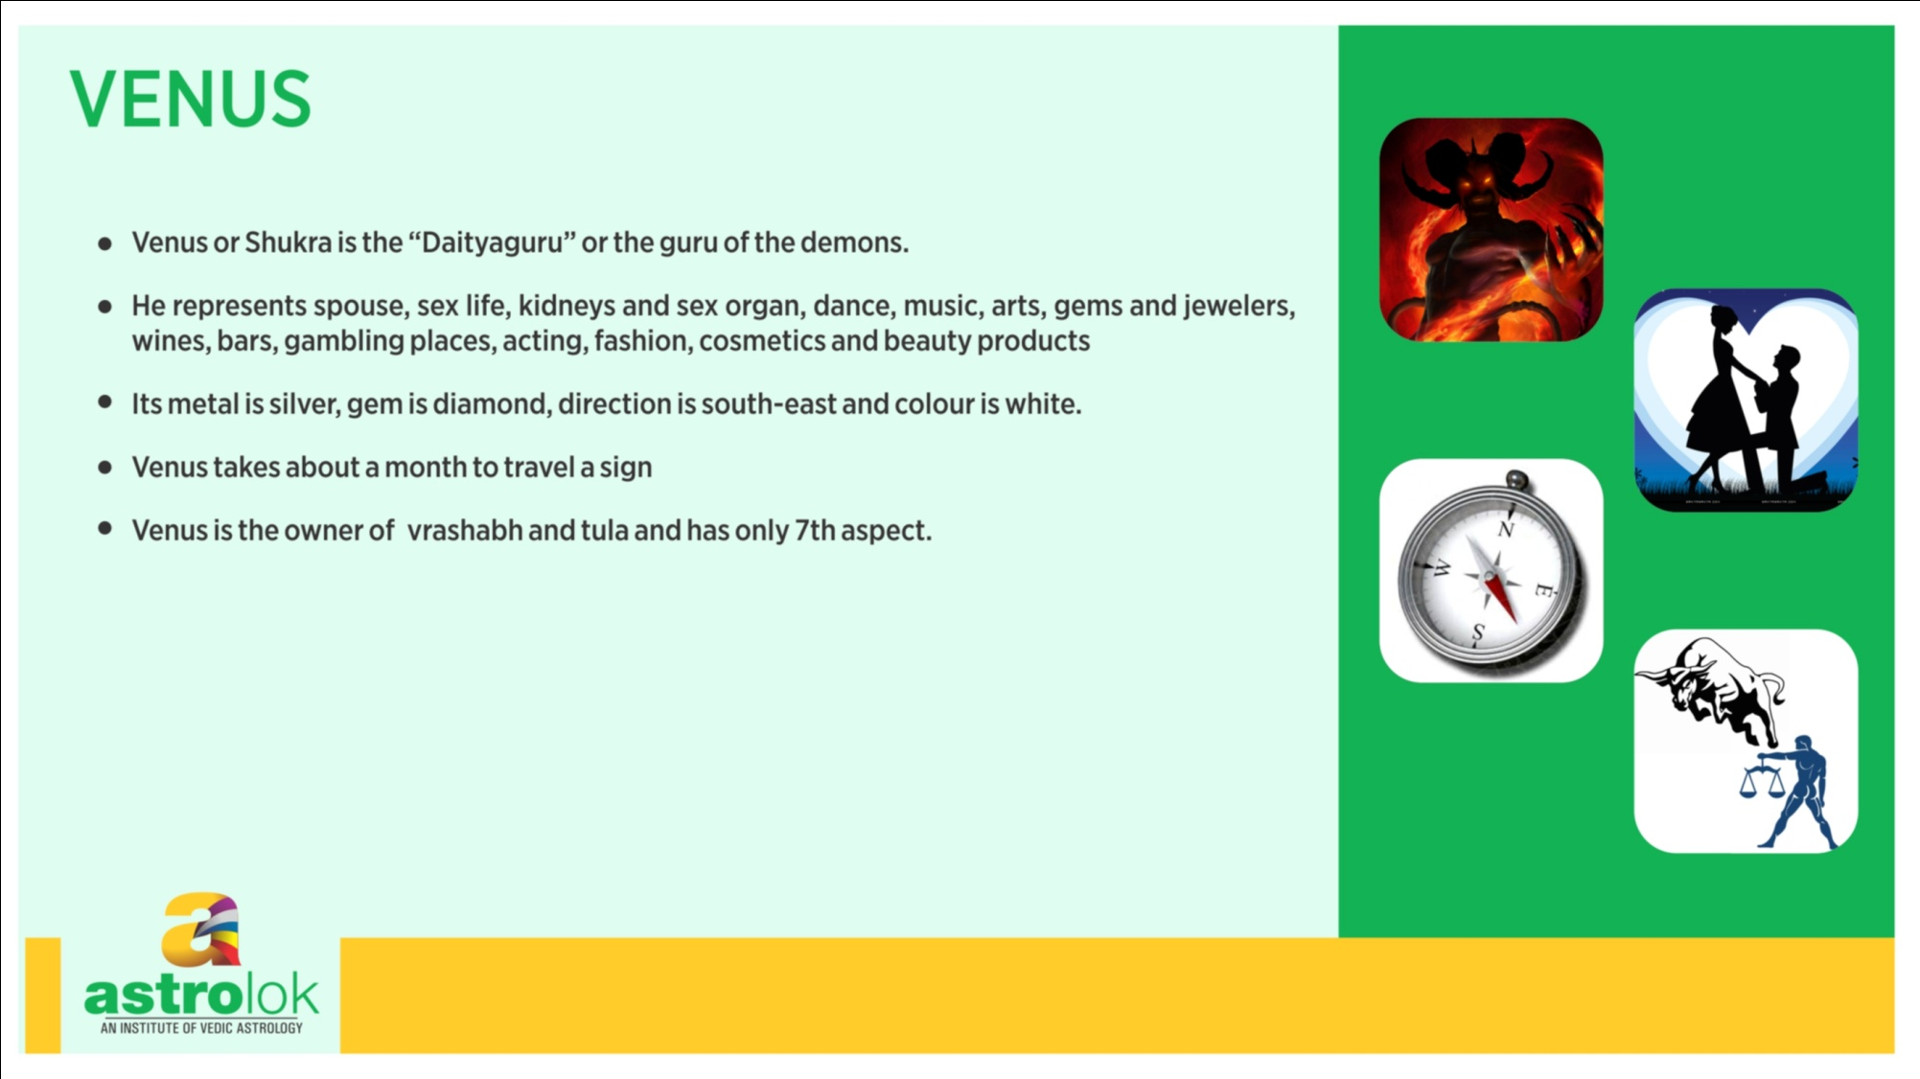

Slide 70
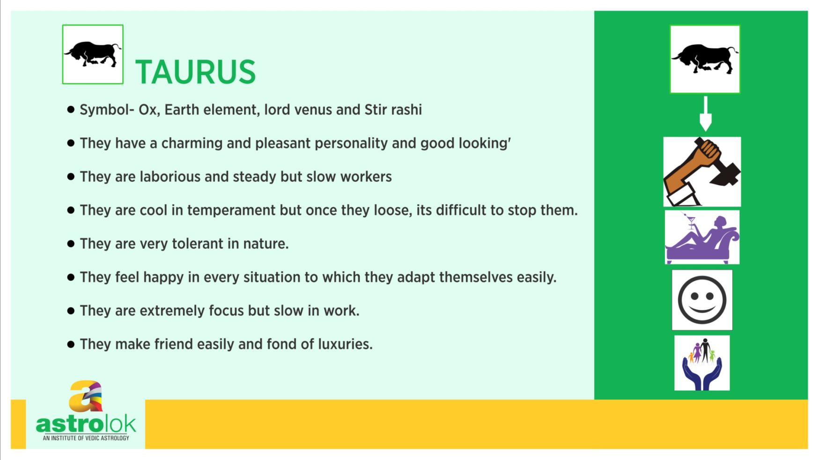

Slide 71
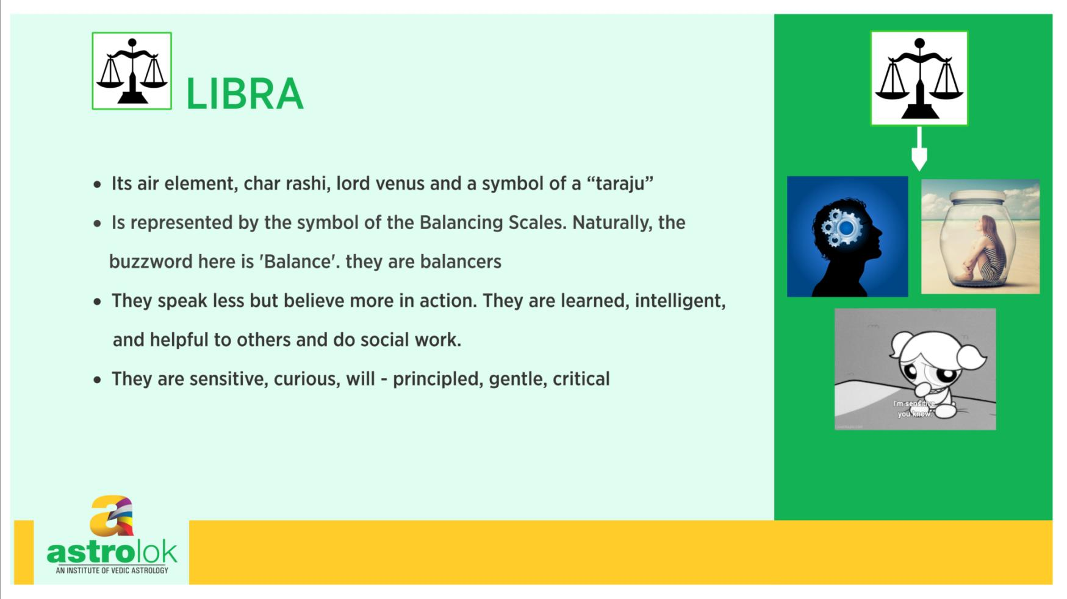

Slide 72
Jupiter- Astronomy
Jupiter is the largest planet in our Solar System. It has a diameter of about 142,800 kilometers. Its closest distance from the Earth is about 588 million kilometers. From Sun its average distance is 778 million kilometers.
Jupiter takes 11.86 years to make one orbit around the Sun and it takes 9 hours and 55 minutes to complete one rotation on its axis.
Its average surface temperature is about -148°C. Its average geocentric motion per day is 00°04'59".
Jupiter have 63 natural satellite of its own out of those Io, Europa, Ganymede and Callisto are well known.
Jupiter retrogrades for about 110 days per year

Slide 73
Story
Jupiter or Brihaspati was one of the eight sons of Angiras, (son of Brahma) and Shraddha.
After receiving initial knowledge from his father, Jupiter left his home in quest for spiritual knowledge and meditated for thousands of years, his penances earned him a place as guru or teacher to the demigods.
His work was to guide then and advancing their cause by thwarting the designs of the Asuras.

Slide 74
Once Bhrigu or Venus, the guru of the devils went to the Himalaya to worship Lord Shiva for obtaining means to conquer and destroy the demigods.
Meanwhile sensing an opportunity, Indra, the king of demigods sent his daughter Jayanti to Venus to obtain whatever he receives from Lord Shiva by deceit. She stayed with Venus for many years as his disciple until he obtained the boon from Shiva.
Then, when he was about to return to the devils, Jayanti requested him to accepted her as wife. He agreed to be her husband but for only ten years and during this period they would be alone.

Slide 75
When Jupiter came to know about this he made a plan and disguised himself as Venus he went to live with the Asuras and during these ten years he succeeded in removing hatred and factionalism from them. When Venus returned home the Asuras got confused seeing two identical gurus and they declared that their real teacher was the one who had been teaching them for the past years.

Slide 76
The real Venus, got angry and left cursing them that they would soon be destroyed. Shortly thereafter Jupiter resumed his real form and returned to heaven.
The Asuras, were now left without a guru and guide approached the real Venus and begged his pardon.
He relented and again became their guru, but his curse had its effect, and for many ages the Asuras were too weak to threaten the gods.

Slide 77
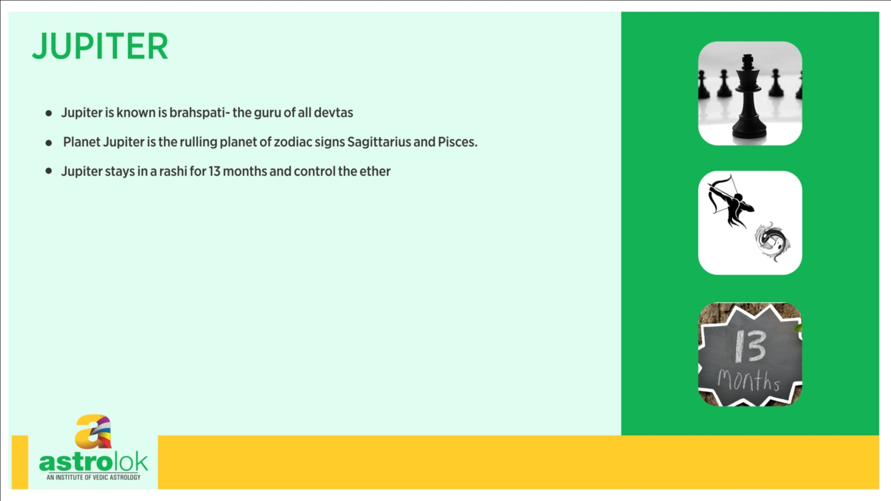

Slide 78
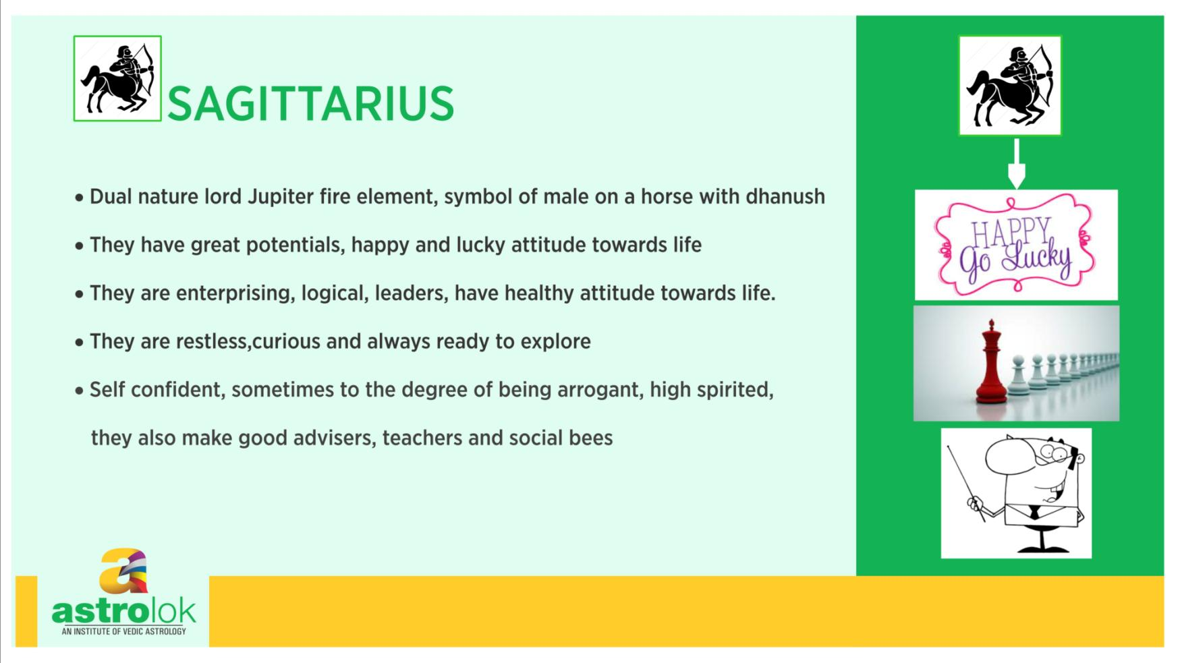

Slide 79
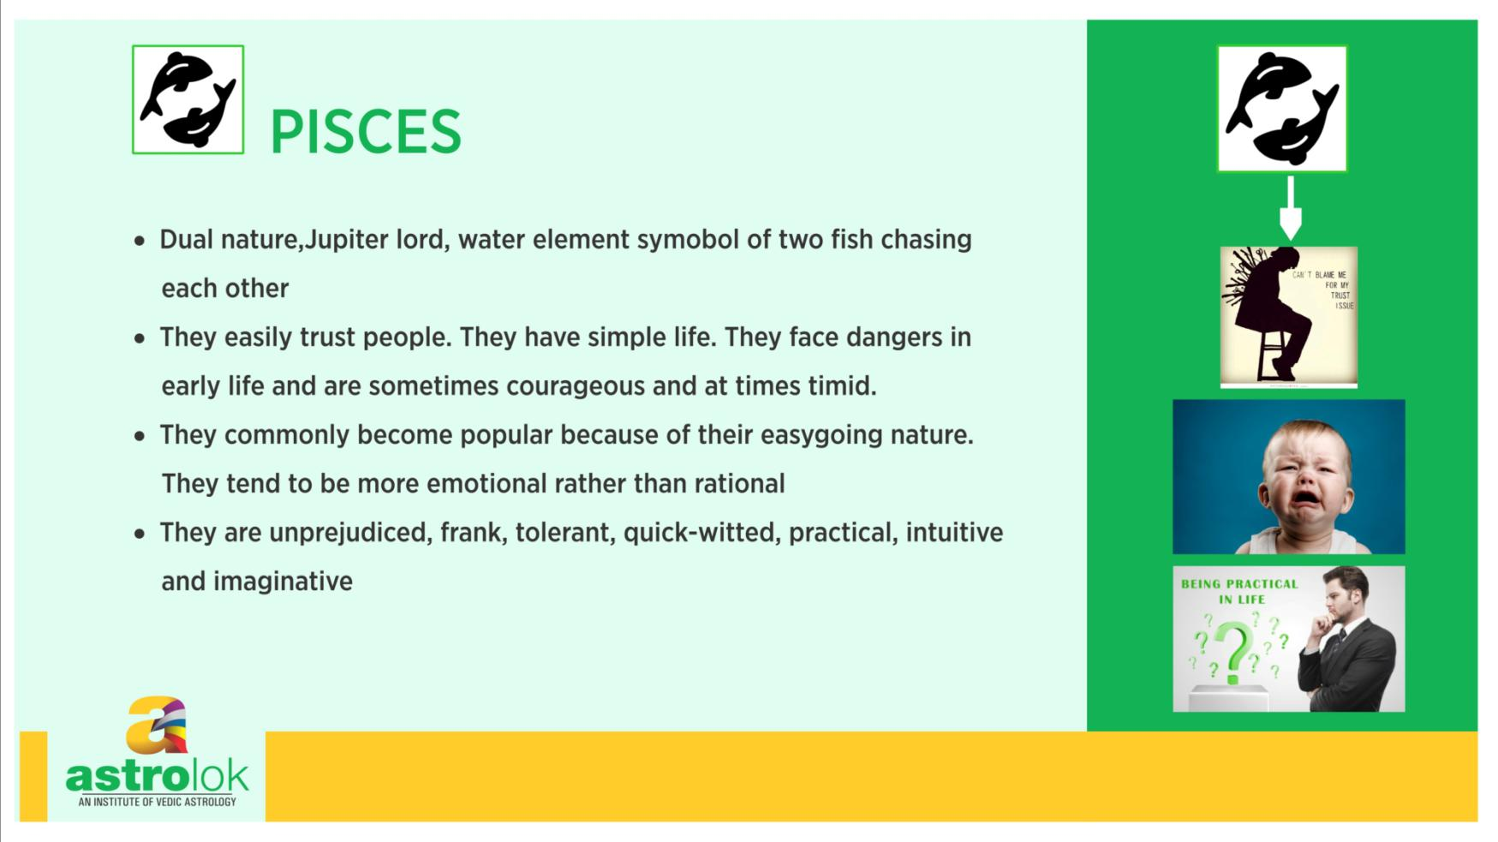

Slide 80
Saturn- Astronomy
Saturn is the second largest planet in our Solar System. Its surface is made up of liquid and gas. Saturn is well known for its complex ring system.
It has a diameter of about 120,660 kilometers. Its closest distance from the Earth is about 1.2 billion kilometers. From Sun its distance varies from 1.35 billion kilometers to 1.5 billion kilometers.
Saturn takes 29.5 years to make one orbit around the Sun and it takes 10 hours 40 minutes to complete one rotation on its axis. Its average surface temperature is –178°C.
Its average geocentric motion per day is 00°02'01". Saturn have 62 natural satellites of which Titan is most famous as it is the biggest satellite in our Solar system.
Saturn retrograde for about 135 days per year.

Slide 81
Story
Saturn is tall, black, long-limbed, and emaciated, with reddish-brown eyes, large teeth and nails, prominent veins, a sunken stomach, a long beard, matted locks, and stiff body.
He is lame and his limbs are rigid; intensely harsh,
he is cruel in authority, and his gaze is utterly terrifying. Saturn is the son of the Sun and his wife's Chaaya (shadow) and is the brother of Yama, the god of righteousness and death. ..

Slide 82
As soon as Saturn was born, his gaze fell on his father and caused vitiligo; his gaze next fell on the Sun's charioteer, who fell and broke his thigh; and next upon the seven horses of his chariot they all went stone blind.
The Sun tried a number of remedies but nothing worked. It was only when Saturn's gaze left them that the Sun's skin cleared, his charioteer's femur healed, and his horses regained their sight.
Saturn became a planet after performing penance in Banaras and propitiating Lord Shiva

Slide 83
When Shiva's son Ganesha was born, his mother Parvati wanted to show the boy to Saturn. Saturn politely advised her not to do so, but when she insisted, he gazed at the child reluctantly with only one eye.
Instantly Ganesha's head was reduced to ashes.
To prevent Parvati in her anger from destroying the universe, Lord Vishnu cut off head of a bull elephant and joined it to Ganesha's body

Slide 84
Saturn is the lord of longevity, death, justice and time. Even King Indra and all the gods panic when Saturn is nearby, for over the ages many thousands of Indras have been overtaken by the power of time.

Slide 85
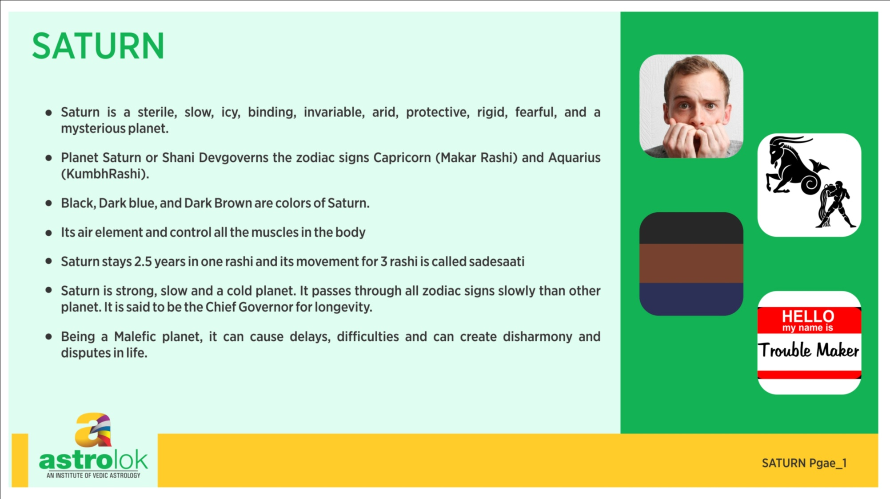

Slide 86
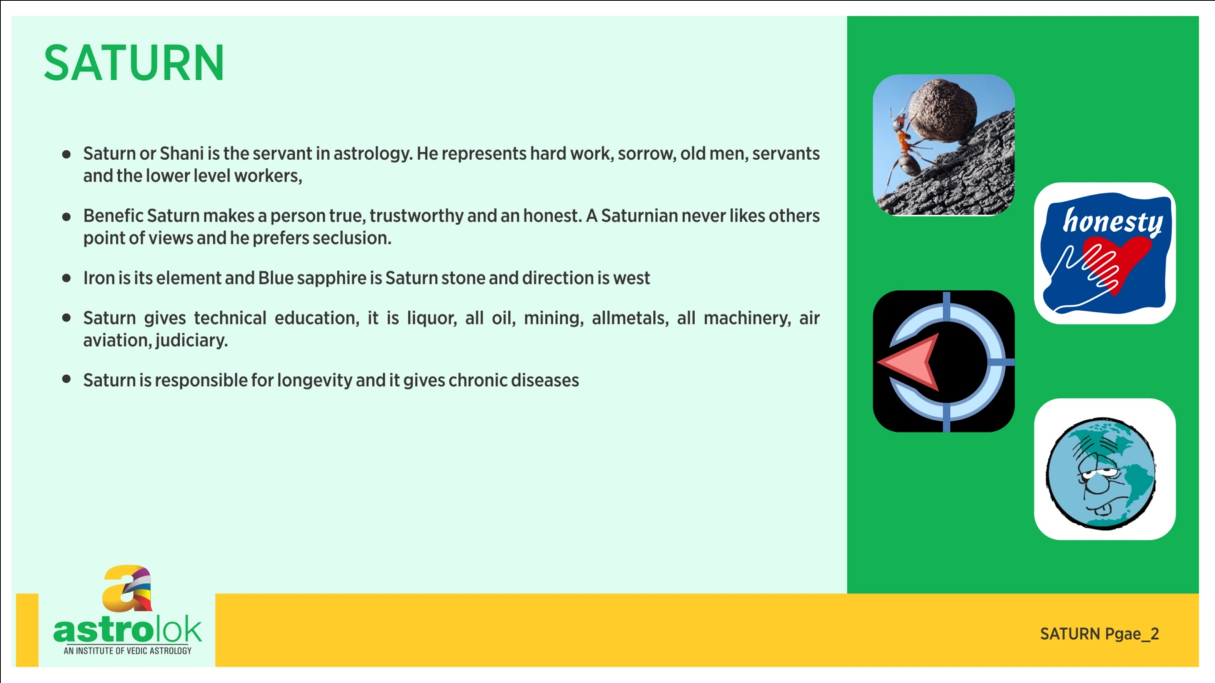

Slide 87
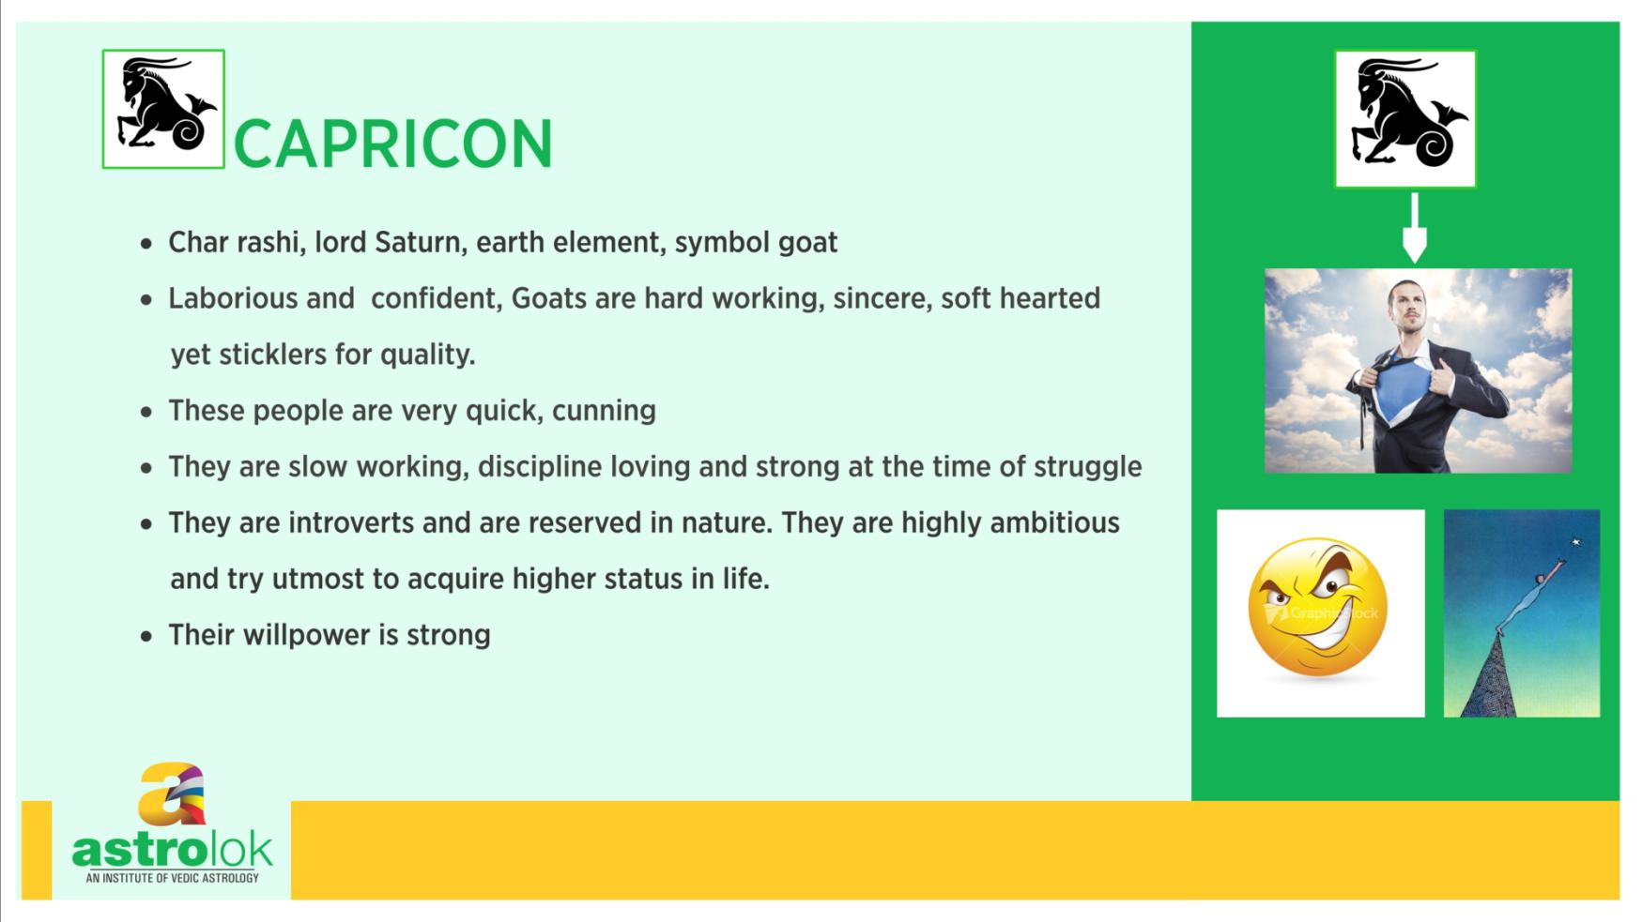

Slide 88
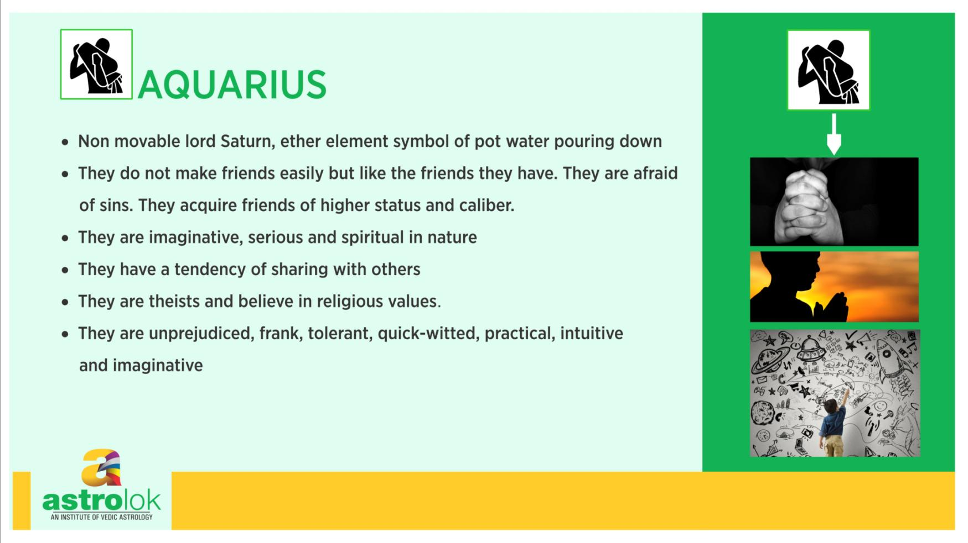

Slide 89
Rahu& Ketu- Astronomy
Astronomically (as per Hindu Astrology), Rahu and Ketu denote the two points of intersection of the paths of the Sun and the Moon as they move around the celestial sphere.
Therefore, Rahu and Ketu are respectively called the north and the south lunar nodes.
The fact that eclipses occur when Sun and Moon are at one of these points gives rise to the myth of the swallowing of the Sun.

Slide 90
The Rahu is the son of Viprachitti and his wife Simhika, the sister of Prahlada. the devotee of Lord Vishnu.
Ketu is the dismembered body of which Rahu is the head.
The demi gods or the Devas were losing their glory and power due to a curse by sage Durvasas and the king of Devas the mighty Indra has lost his kingdom, the heaven to Asuras or the devils.

Slide 91
The Devas approached supreme father, and creator or universe, Lord Brahma for help, who guided them to Lord Vishnu, the preserver of universe.
Lord Vishnu made a plan and suggested Devas to approach the Asuras and ask them for their co operation in churning the mighty ocean to obtain amrita, the nectar of immortality, which Devas and Asuras can divide among themselves and can become immortal.
The Devas approached Asuras who agreed as this task required combined efforts of both Devas and Asuras.

Slide 92
They started churning using Mount Mandara as a rod and the Serpent Vasuki as a rope.
Lord Vishnu incarnated as a Tortoise to hold up the mountain on his back. As the churning of the ocean started several things energed as a result, starting with poison Halahala which threatened to destroy all the universe but Lord Shiva kept it in his throat, without swallowing it.
Kamadhenu, the wish-fulfilling cow, celestial horse Ucchaishravas, Airavata, the celestial elephant, the Kausthubha gem, the Parijataka (wish-fulfilling tree), Apsaras, the beautiful celestials maids, Lakshmi, the goddess of prosperity, Varuni, the goddess of liquor appeared one by one.
Finally Dhanvantari, the god of medicine, appeared holding the pot of amrita. The Asuras forcefully snatched it, and refused to give it to Devas. .

Slide 93
Lord Vishnu then incarnated as Mohini, the enchantress, the most beautiful female form in the universe.
Devas knew this plan and controlled themselves but the Asuras were overwhelmed with lust for her and agreed to her decision for distribution of nectar as per her rules.
She asked all the Devas and Asuras to sit in a line and started distributing nectar first to Devas.
Rahu disguised himself as one of the Devas and sat between the Sun and Moon gods, who recognized him and told Vishnu who was in the form of Mohini.
Lord Vishnu severed Rahu's head with his discus, the sudarshan charka but not before he managed to drink a drop of the nectar and become immortal

Slide 94
Thus his Head and Body become separate but both become immortal as separate entity due to nectar.
The Head is known as Rahu and the headless body is the Ketu. Since then Rahu and Ketu constantly chase Sun and Moon for revenge for they are the cause of separating head and body of the devil Rahu.
And when they succeed catching Sun and Moon they swallow them causing Solar or Lunar eclipse but they cant hold them for long and Sun and Moon emerges again intact as they also had nectar and are immortal.

Slide 95
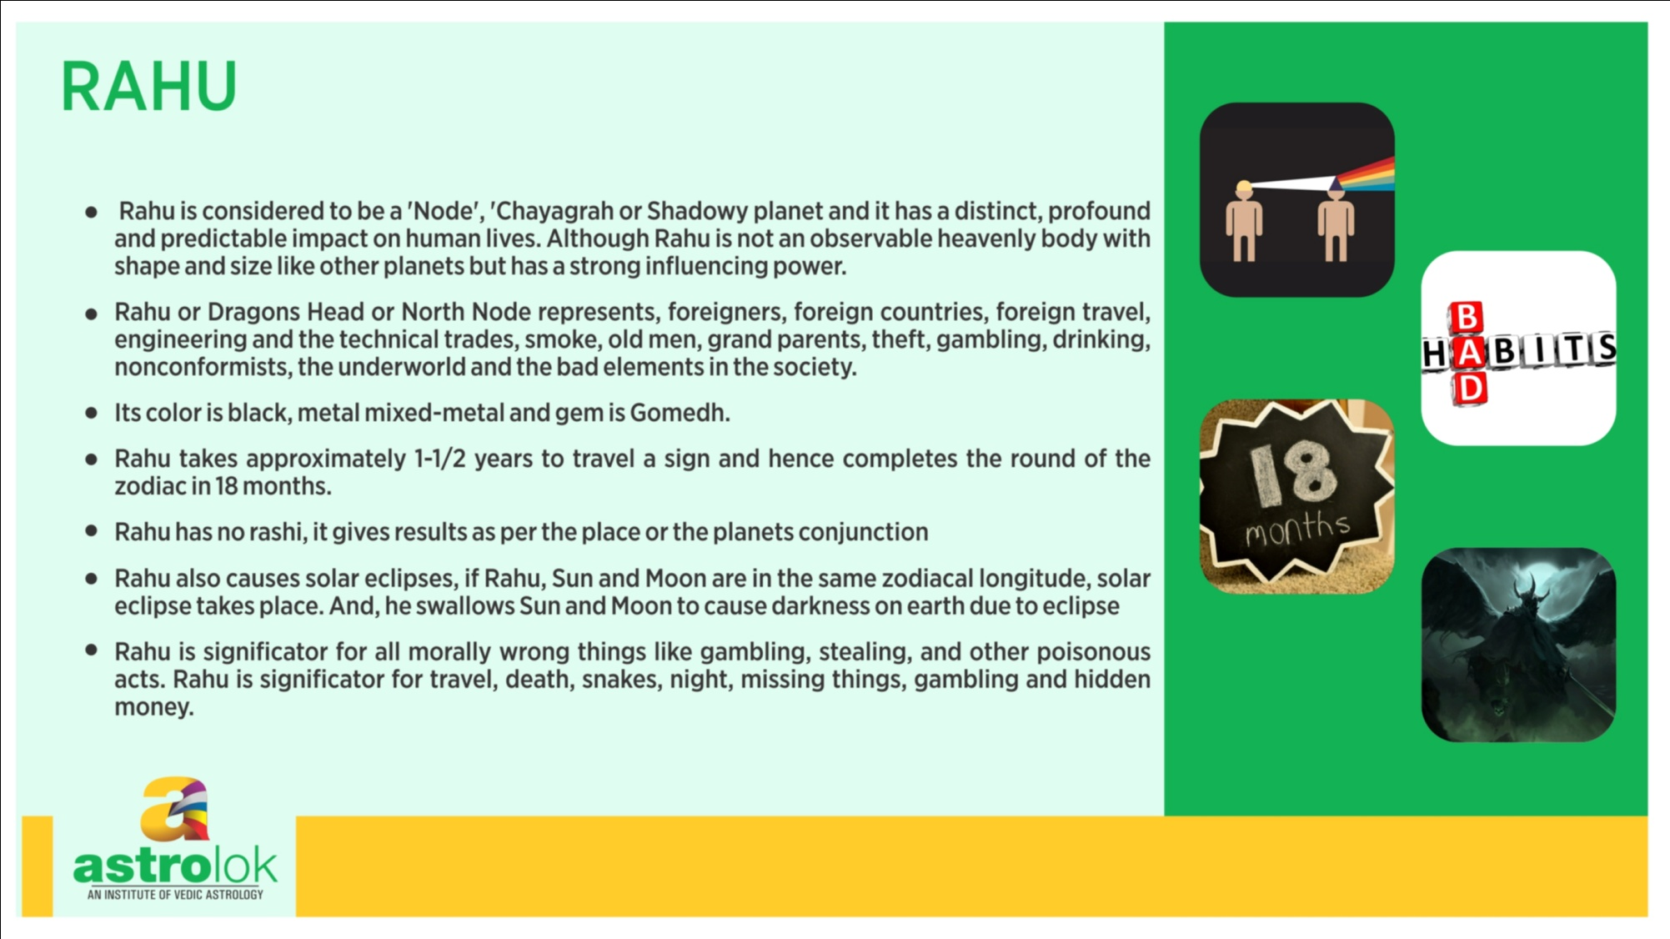

Slide 96
